Slide 1
Lord’s work in Africa

Slide 5
bBa

Slide 7
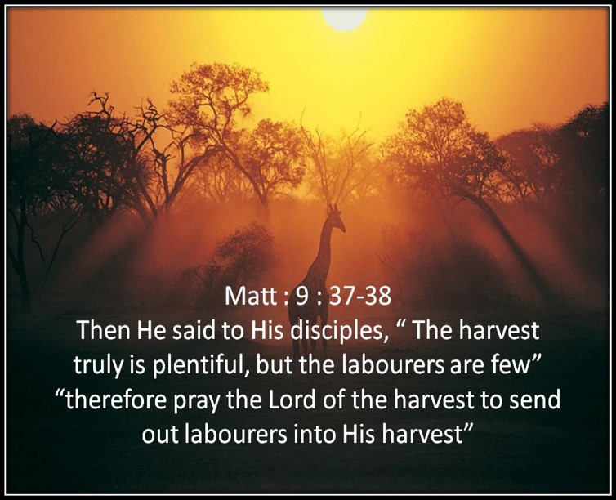

Slide 8
Places of Worship

Slide 9
Places of Worship

Slide 10
John 4:24 “god is spirit and those who worship him must worship in spirit and truth”

Slide 11
Places of Worship

Slide 13
Baptism in Botswana Villages

Slide 14
Baptism in crocodile waters Zimbabwe

Slide 15
Men Training

Slide 16
Life in an African village

Slide 17
Basic living conditions very poor

Slide 18
Outside kitchens

Slide 19
Hard living conditions

Slide 20
Food preparations

Slide 21
Village transport

Slide 22
Children of Africa

Slide 23
Ivy teaching the children

Slide 30
Subsistence farmers

Slide 31
All farming done by hand

Slide 32
Dry conditions DUE TO Persistent DROUGHT

Slide 33
Regular Drought

Slide 35
You Loving brethren heard their plea

Slide 36
Food purchased and loaded

Slide 37
Food delivered to our brethren

Slide 38
Brethren grateful to receive your gift

Slide 39
Long term food solutions

Slide 40
Wells drilled for each congregation in Zimbabwe

Slide 41
Sola pumps installed

Slide 42
Water tanks and Taps installed

Slide 43
Fencing material bought

Slide 44
Fields fenced and prepared

Slide 45
Fields planted

Slide 46
Success the harvest

Slide 47
CHALANGES IN THE WORK
1)The distance I travel each month is an average of 4000 -5000 miles per month on bad roads , my pick-up takes a hammering and does not last longer than 3 years without becoming unreliable .New vehicles are very expensive in South Africa .
2)Price of gas has direct impact on my work due to distances traveled and put pressure on my budget .

