Slide 1


Slide 2

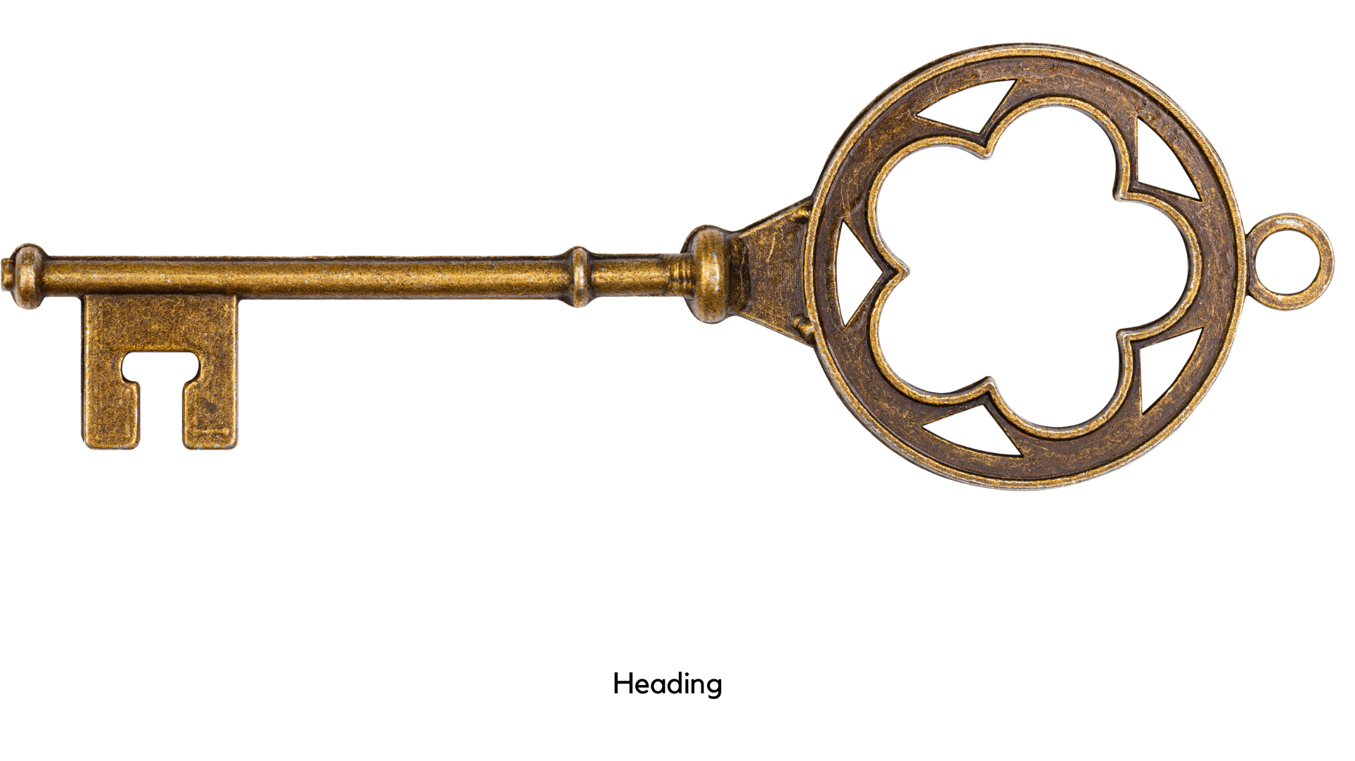
AUDIENCE
BACKGROUND
4 KEYS OF REVELATION
TIMEFRAME
STYLE
Notes:
THE KEYS
Revelation does seem like one confusing puzzle for many who study it.
However, there are some principles that will help us put that puzzle together and unlock some of the mystery of the book for us, if we will allow these principles to guide us in our study.
All of these principles can actually be found in the first chapter.

Slide 3
Style - Numbers
1 – Singularity
2 – Duality
3 – God’s Actions
3 ½ - Things in process (incomplete)
4 – Earth
6 – Human
effort/incomplete
7 – divine completion
10 – completion
12 – human completion

Slide 4
The Allies
Chapter 4
The Scene
  A throne with someone on it
  Emerald rainbow
  Thrones & Elders
  Seven lamps of fire burning before the throne
  A sea of glass before the throne
  Four living creatures around the throne
    (lion, calf, face like a man, eagle)

Slide 5
The Allies
Chapter 4
The Action
  4 living creatures worship God
  24 elders worship God
  “Worthy are you…to recieve glory and honor and power.”

Slide 6
The Allies
Chapter 5
A search for someone WORTHY to open the scroll
The Lion of the tribe of Judah is WORTHY
The Lamb
  Seven horns, seven eyes, standing as if slain
He takes the scroll from God.

Slide 7
The Allies
Chapter 5
The Lamb - Jesus
  Lion of the tribe of Judah, Root of David
  Standing as if Slain
  Purchased with his blood men of every tribe
  He is worshiped with Him on the throne

Slide 8
The Allies
Future Images of Jesus (The Lamb)
Revelation 12:1-6
Revelation 14:1-5
Revelation 19:11-21
He Lead’s the Forces of God!!

Slide 9
The Enemies
Chapter 12
A Great Red Dragon
  7 heads
  10 horns
  Diadems on each head
  His tail sweeps away 1/3 of the stars of heaven

Slide 10
The Enemies
Chapter 12
Scene 1) Wants to devour the child of a pregnant woman
Scene 2) Wages war with Michael and his angels
Scene 3) Wages war with the woman & her offspring

Slide 11
The Enemies
The Dragon’s Motive – Chapter 12
Scene 1) Wants to devour the child of a pregnant woman

Slide 12
The Enemies
The Dragon’s Motive – Chapter 12
Scene 2) Wages war with Michael and his angels
The War
  In heaven
  Michael (his angels) vs. Satan (his angels)
  Satan Loses this battle

Slide 13
The Enemies
The Dragon’s Motive – Chapter 12
Scene 3) Wages war with the woman & her offspring
“those who keep the commandments of God and hold to the testimony of Jesus”
-vs. 17

Slide 14
Allies & Enemies
Allies
Chapter 4 – God on His Throne
Chapter 5 – The Lamb and the Scroll
Enemies
Chapter 12 – The Great Red Dragon

