Slide 1
The Three Divisions
Of The Bible
Please Get A Copy Of The Handout

Slide 2
INSPIRATION
Strong’s = Divinely breathed in
(God Breathed – from His breath)
2 Timothy 3:16-17; 2 Peter 1:20-21;
1Cor. 2:10-13; Ephesians 3:3-5; 1 Cor. 14:37

Slide 3
Patriarchal
Law
Scripture
Promises
To Patriarchs
Genesis 1 – Exodus 19
Genesis 12:1 – 3

Slide 4
Mosaical
Law
Scripture
Effected
Through Moses (Acts 13:38 –39)
Exodus 20 – Acts 1
Israelites (Ex. 19:5 – 6; 31:12 – 17)

Slide 5
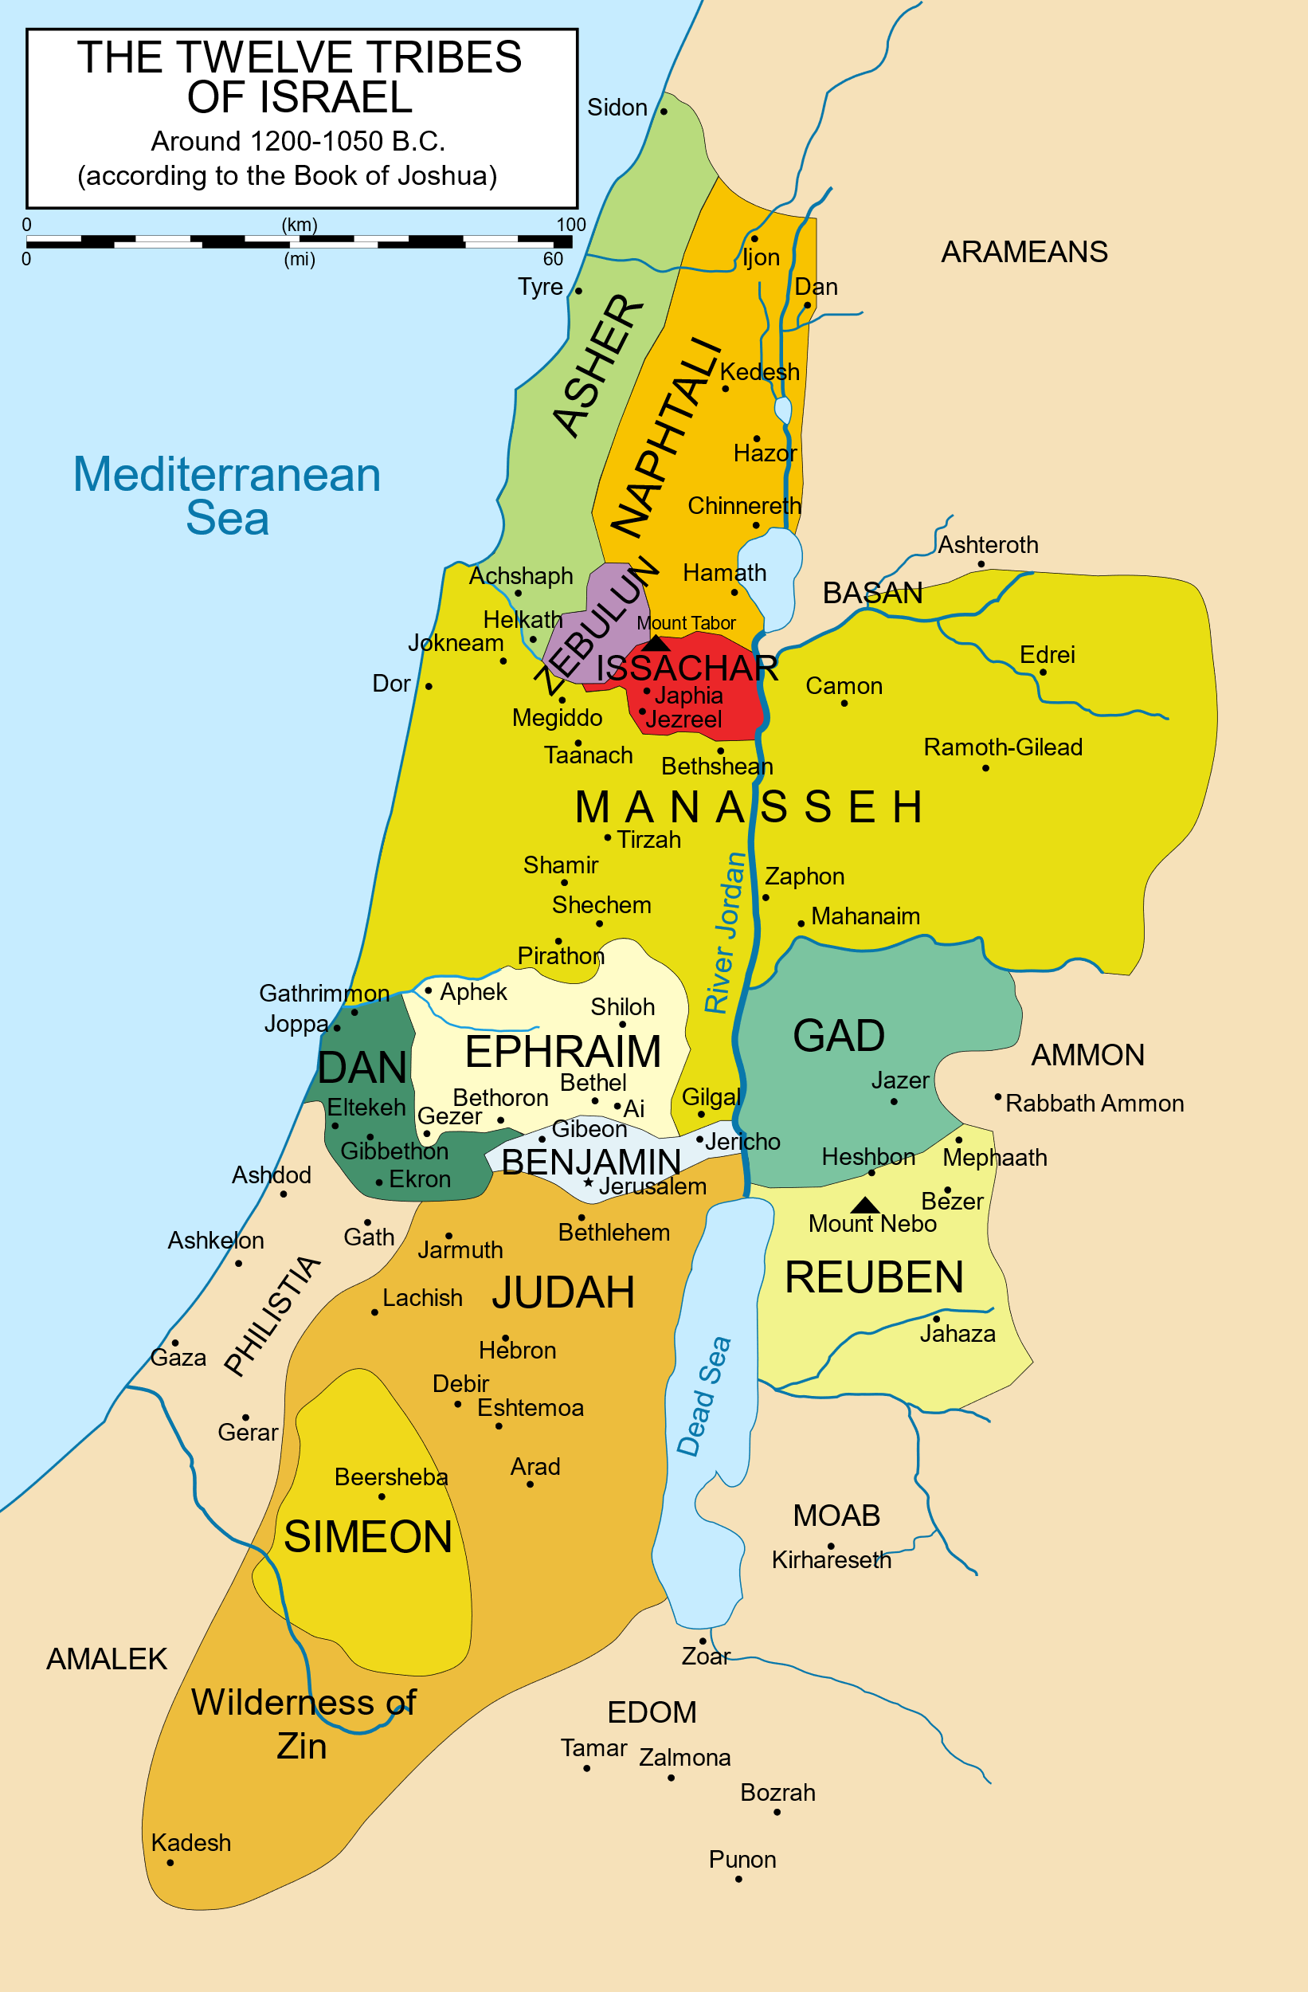

Slide 6
Mosaical
Law
Scripture
Effected
Not Do
Through Moses (Acts 13:38 –39)
Exodus 20 – Acts 1
Israelites (Ex. 19:5 – 6; 31:12 – 17)
Hebrews 10: 1 – 4

Slide 7
Christian
Law
Scripture
Effected
Now…
Through Christ (John 12:48)
Acts 2 – Revelation 22
All People (Eph. 2:11 – 17; Col. 1:14)
Eph. 1:7; Col. 1:14

Slide 8
Which Law Do We Follow Today?
Galatians 3:23 – 29
Hebrews 10:8 – 10
Galatians 2:21
Galatians 5:2 – 4

