Slide 1


Slide 2
The Physical Environment
Size of the room.
Seating Options.

Slide 3
Current Seating Arrangement
Have 28 chairs.
Need max
of 18.
High School Room

Slide 4
28 chairs.
More students are closer to teacher.
High School Room

Slide 5
21 chairs.
Everyone same distance from teacher.
High School Room

Slide 6
20 chairs
Teacher stands in the middle.
Better for discussion.
High School Room

Slide 7
18 chairs
Teacher stands in the middle.
Even better for discussion.
High School Room

Slide 8
21 chairs
Better for visuals and ease of seeing students.
High School Room

Slide 9
18 chairs
Better
for small break-out groups.
High School Room

Slide 10
20 chairs
Better for student presentations
and role playing.
High School Room

Slide 11
18 chairs
Very effective if studying unity or how we are to be close to one another in love.
Have students move toward circle
before class ends.
The seating change is very memorable.
High School Room

Slide 12
The Physical Environment
Size of the room.
Seating Options.
Temperature
Cleanliness
Teaching Walls

Slide 13
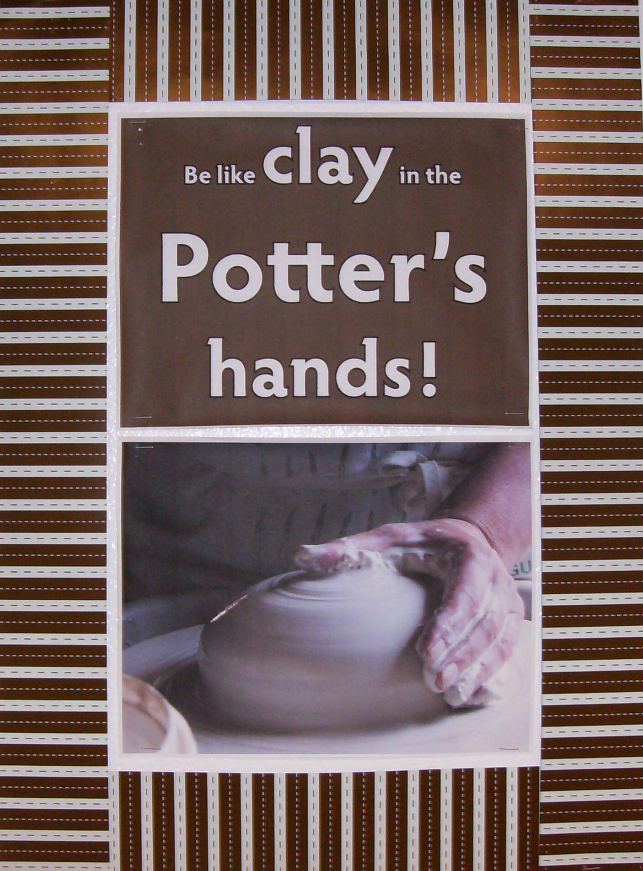
Two home made printed pieces of paper. One with letters, one with art.
2 pieces of border trim. Print words with color that matches the trim you have.

Slide 14
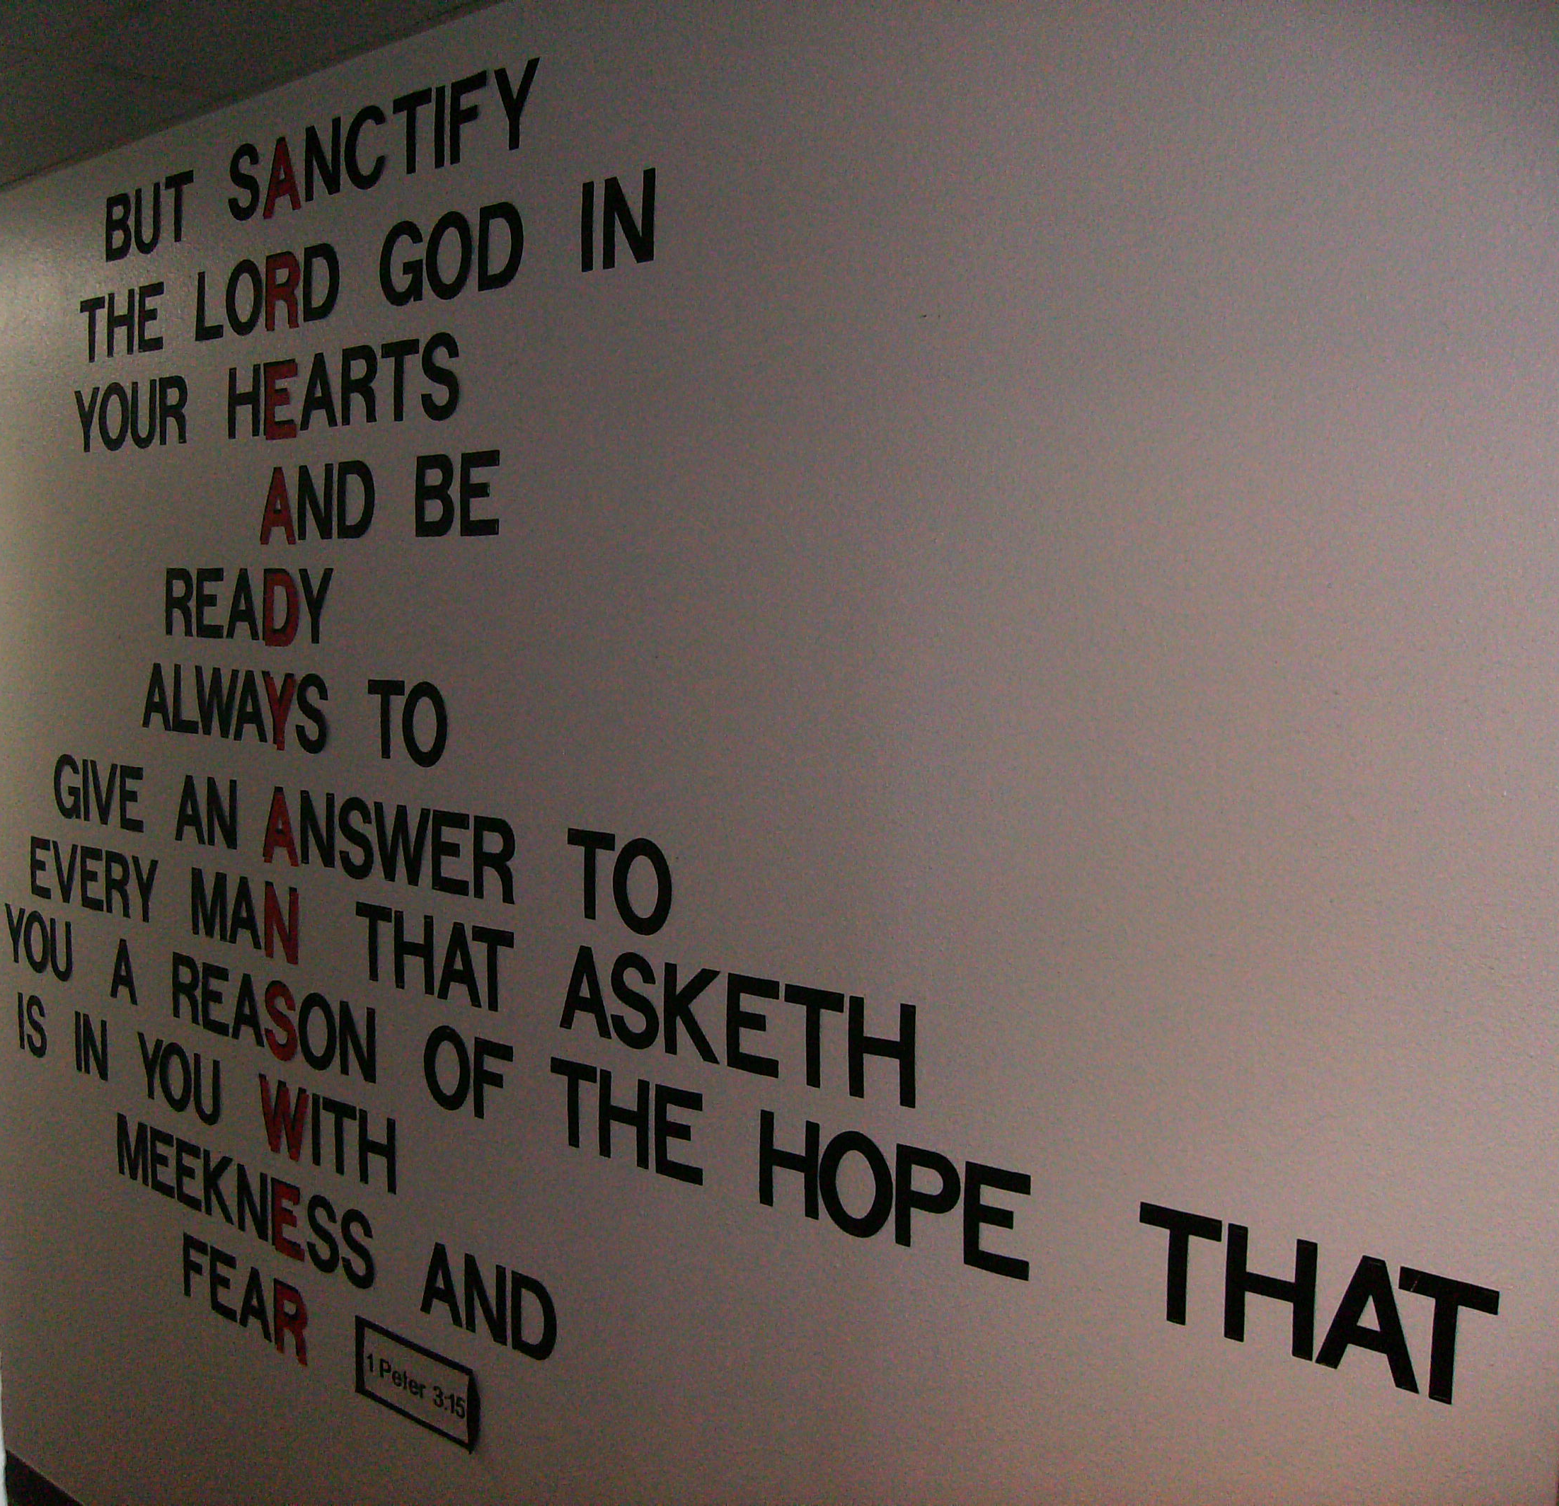
Used in a hallway (angled picture).
Read letters say:
A Ready Answer
The rest is 1 Peter 3:15.
Die cut letters, time to cut and staple neatly.
Other verses can be good for walls.

Slide 15
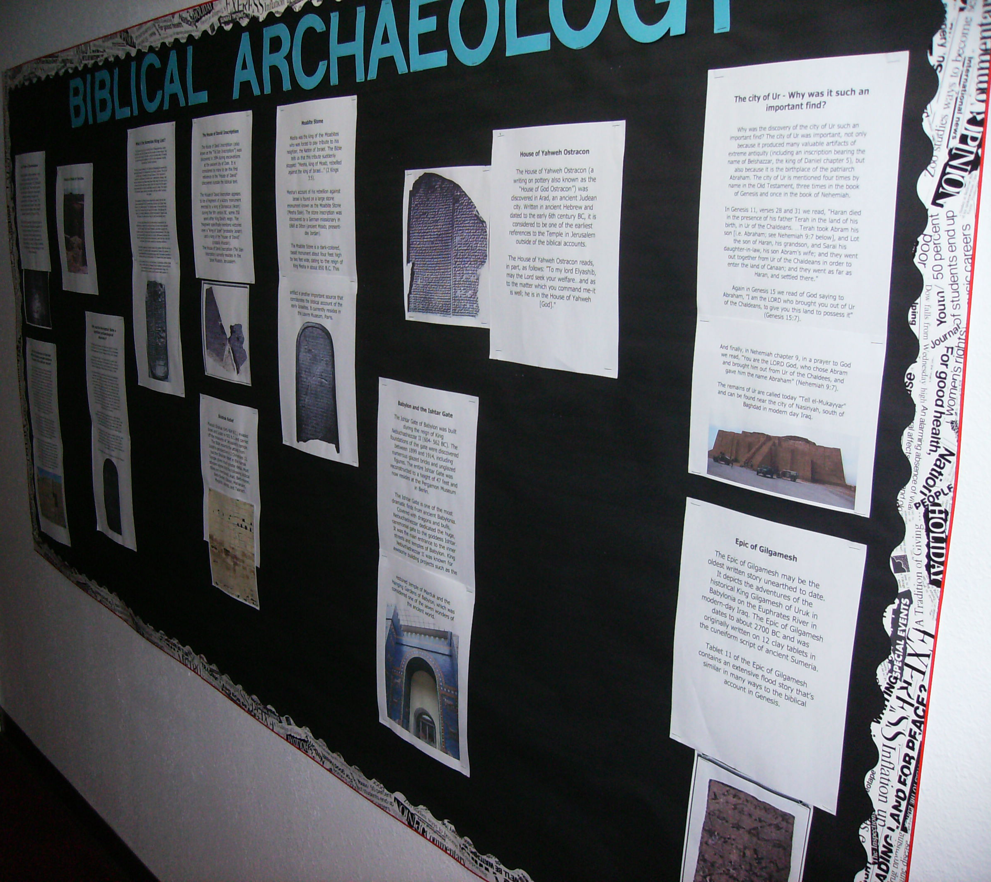
Easy to create in a computer. Art and words can be found online.
Try looking at Steve Rudd’s website:
Bible.ca

Slide 16
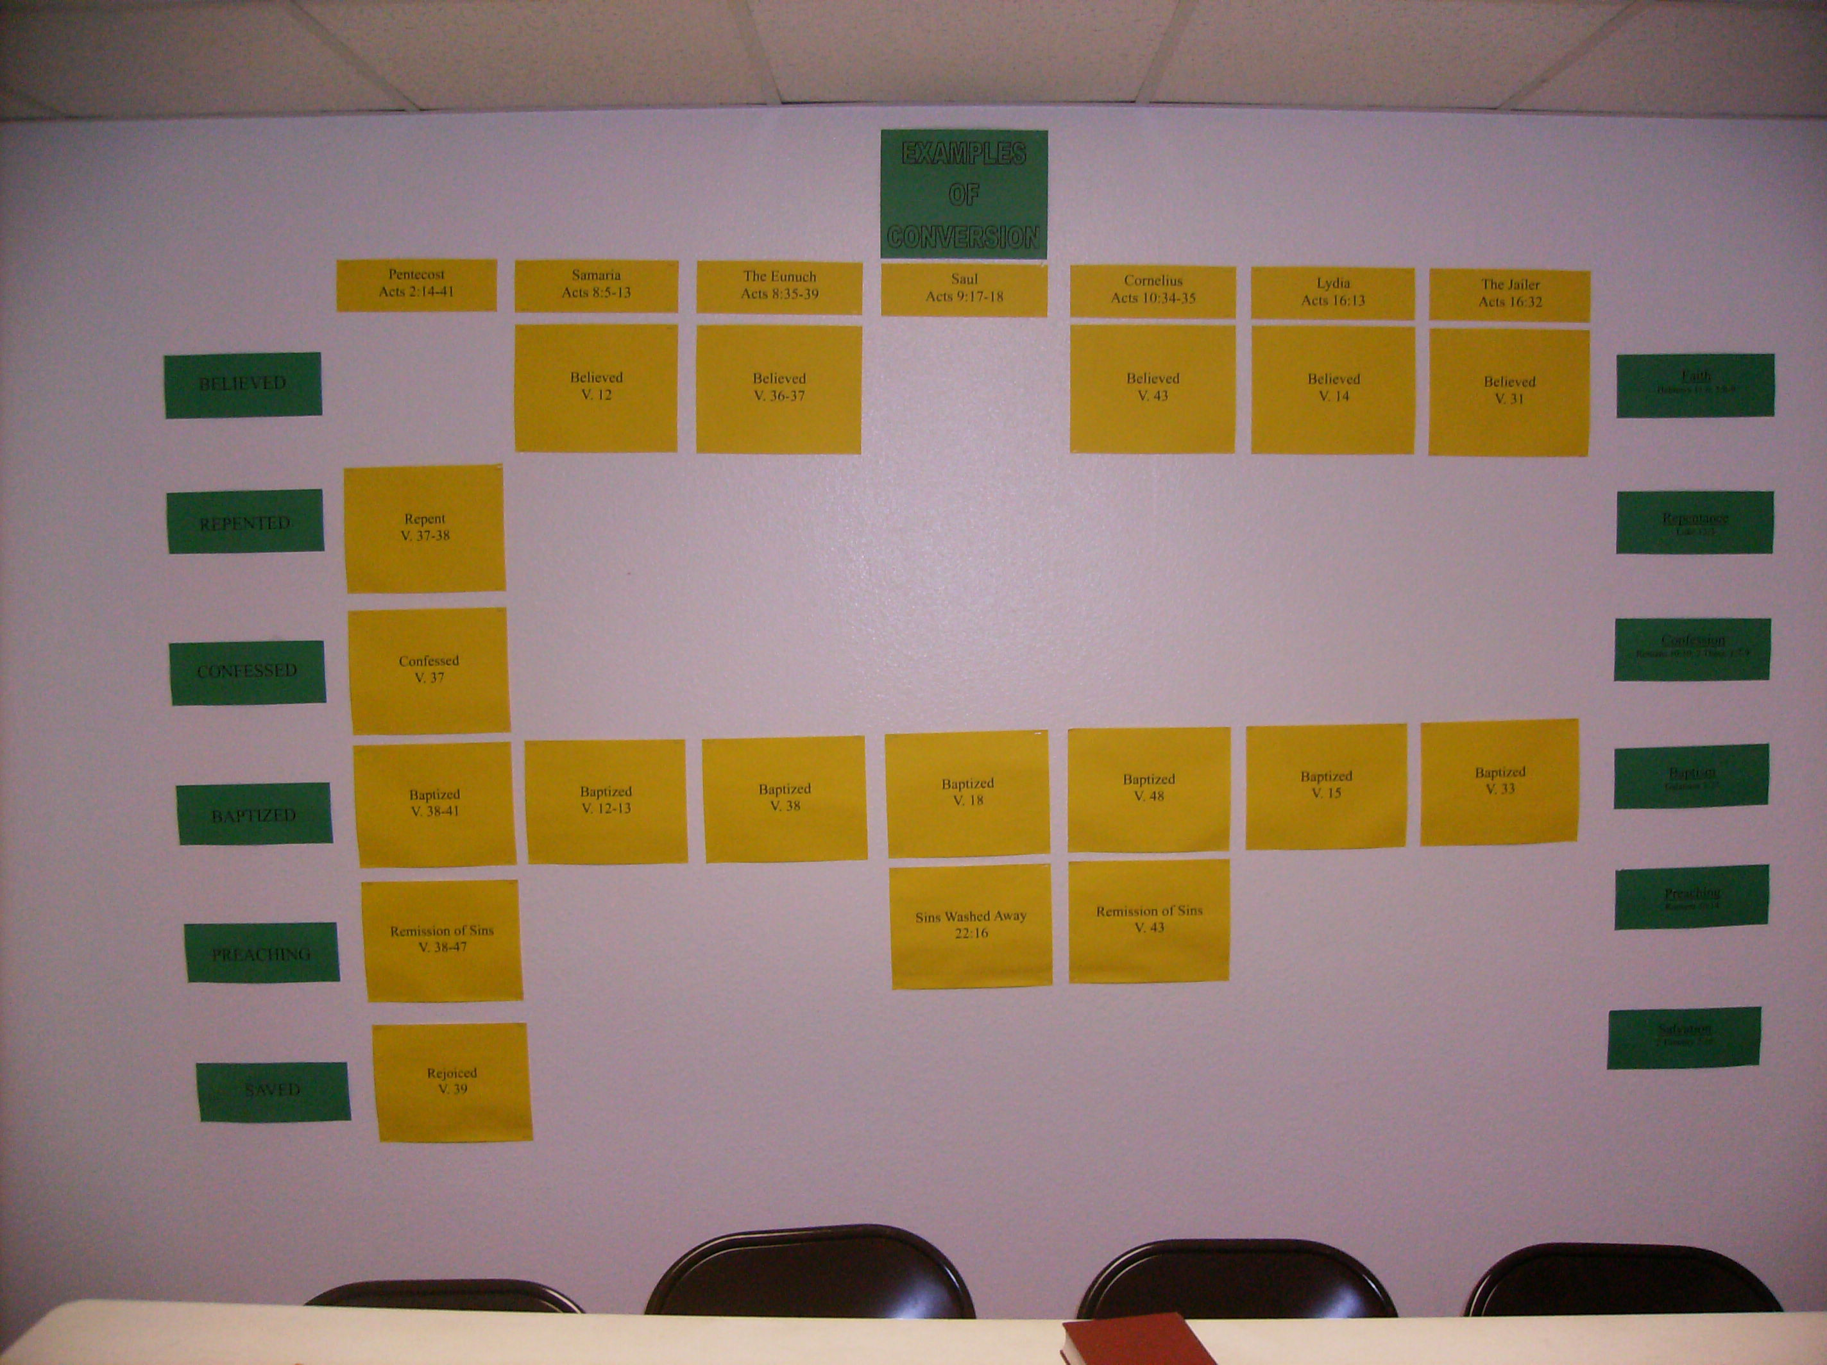
Cases of conversion in Acts.
Very appropriate for a Jr. High room.
Easy computer printed on color paper.

Slide 17
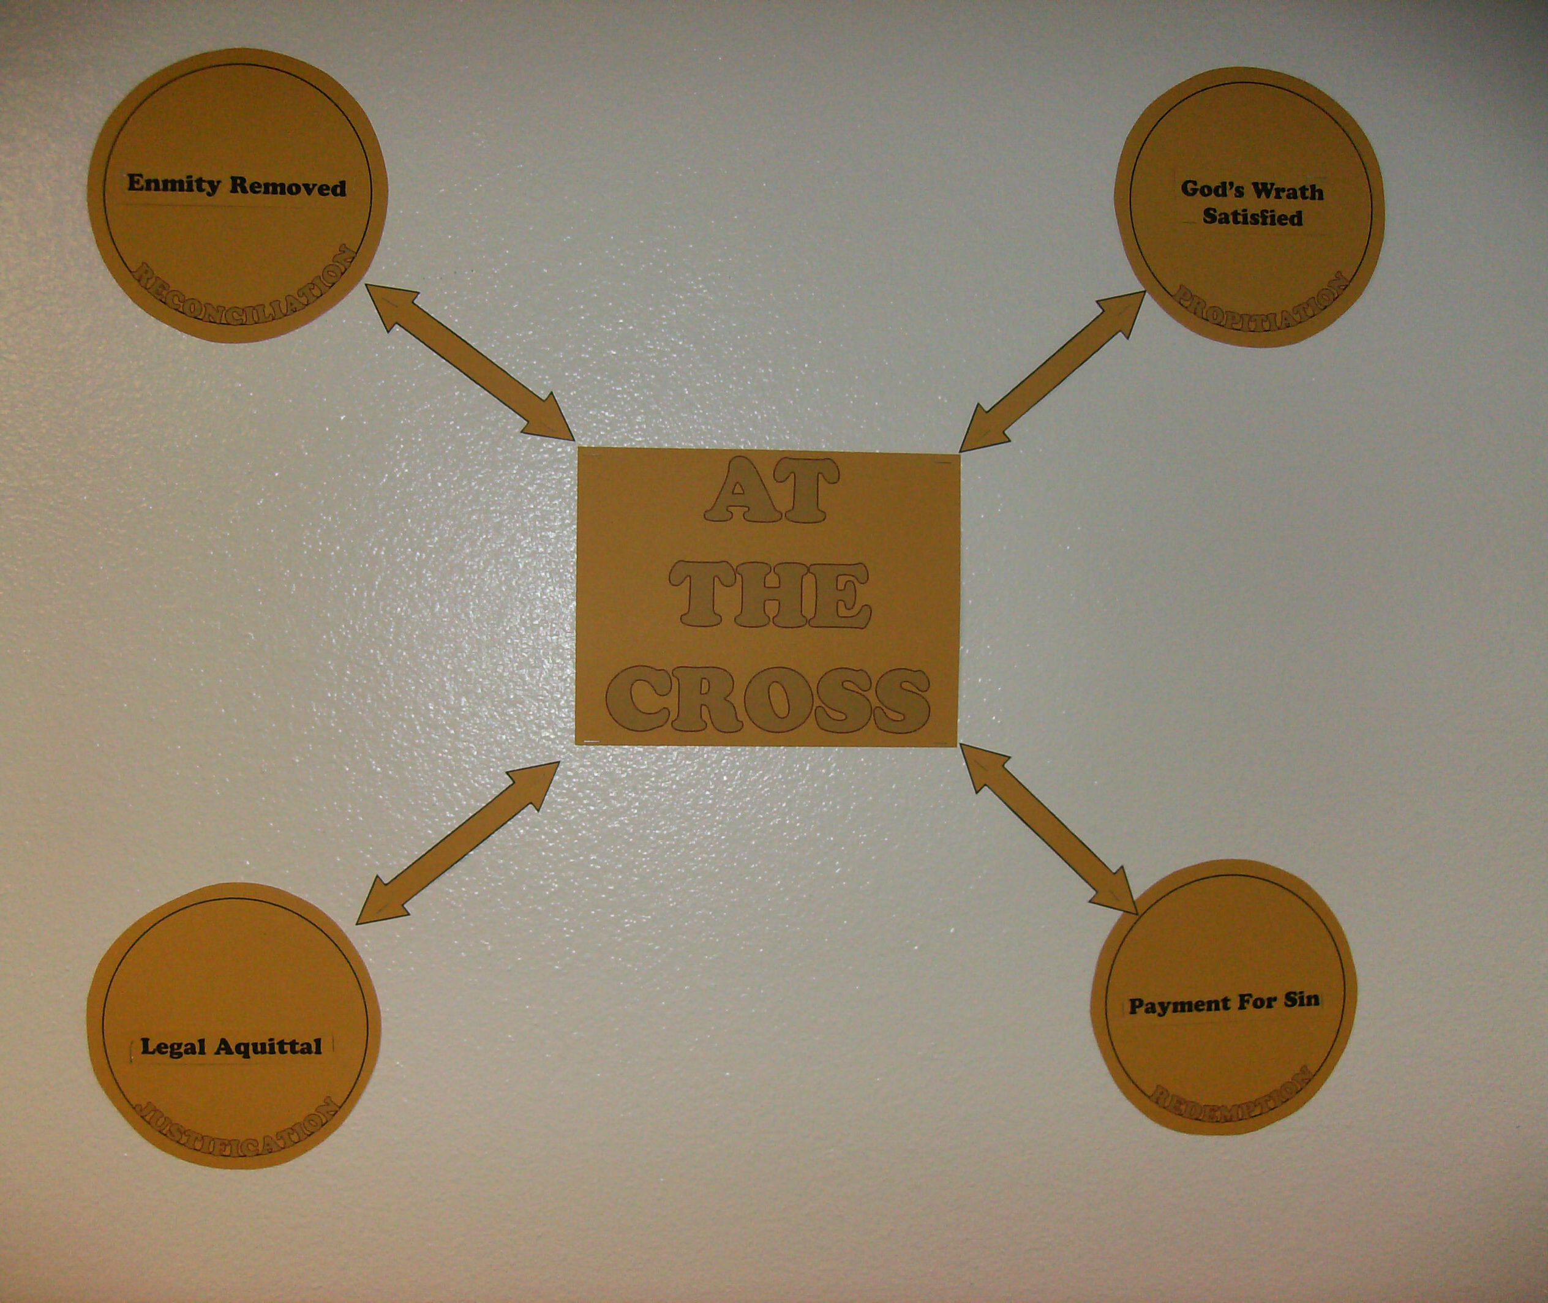
Used in High School class studying Romans.
This was a definition exercise.
Students had to agree where to place the black words and staple them up.

Slide 18
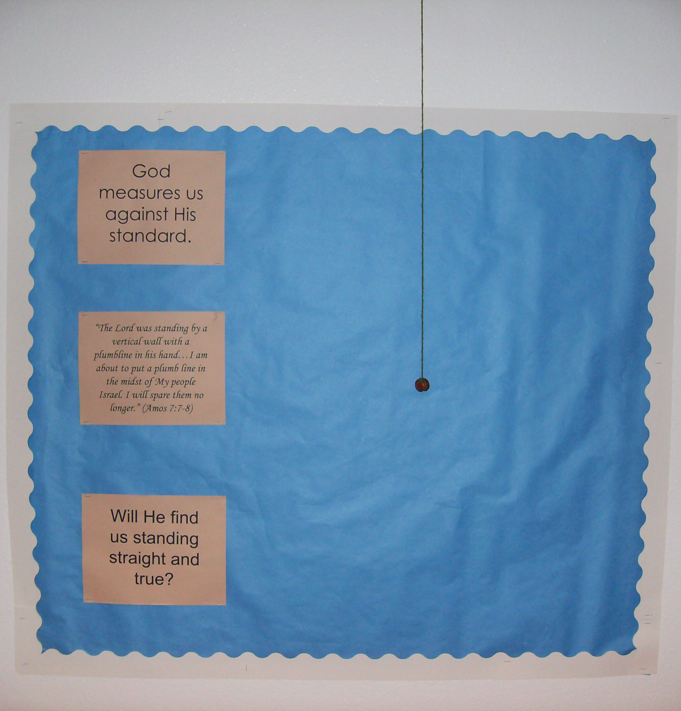
Simple to the point of memorable.
A weight on yarn hung from drop ceiling frame. Three printed pages.
Not hard.

Slide 19
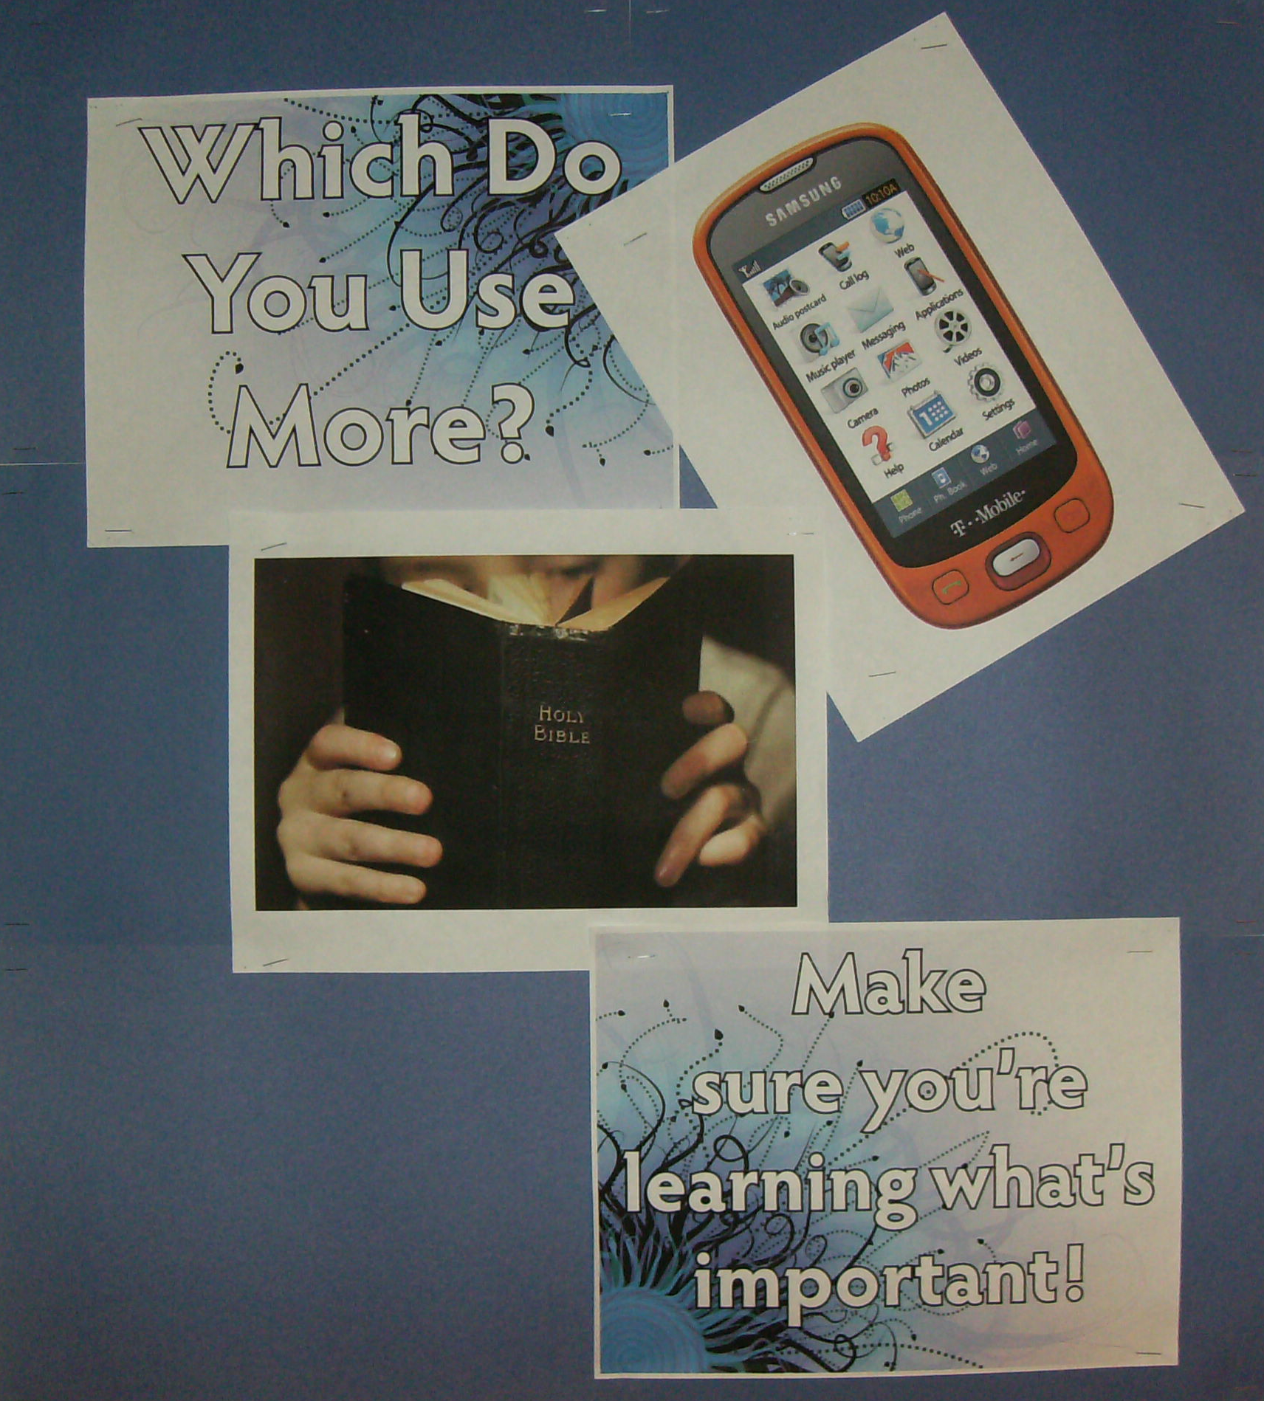
Four printed pieces of paper.
Background is 6 oversize construction paper pages.
I used it with no border trim.
Not hard.

Slide 20
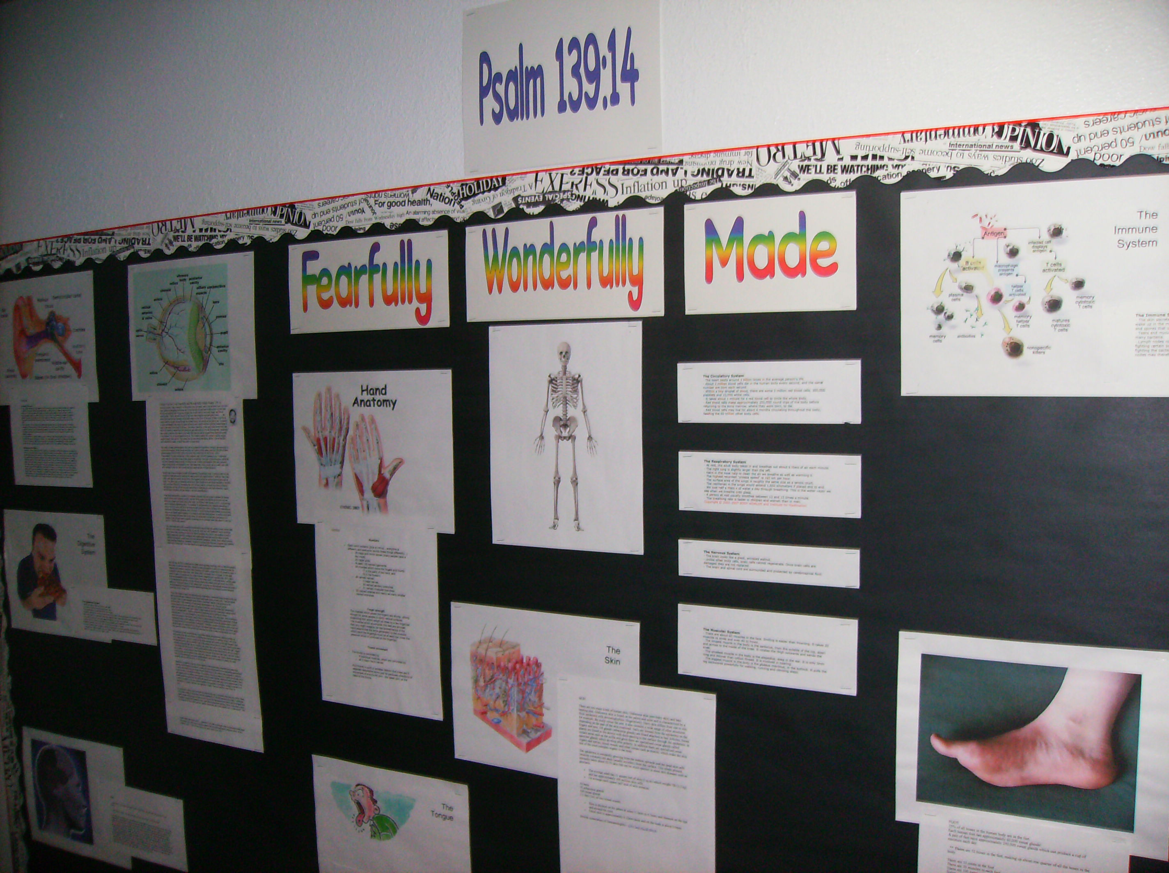
Definitely harder.
Still – all printed on regular paper.
Articles point to Scriptures and scientists pointing to design.

Slide 21

All printed pages.
Die cut letters with colored paper to match printed letters.
Great for Jr. High.

Slide 22
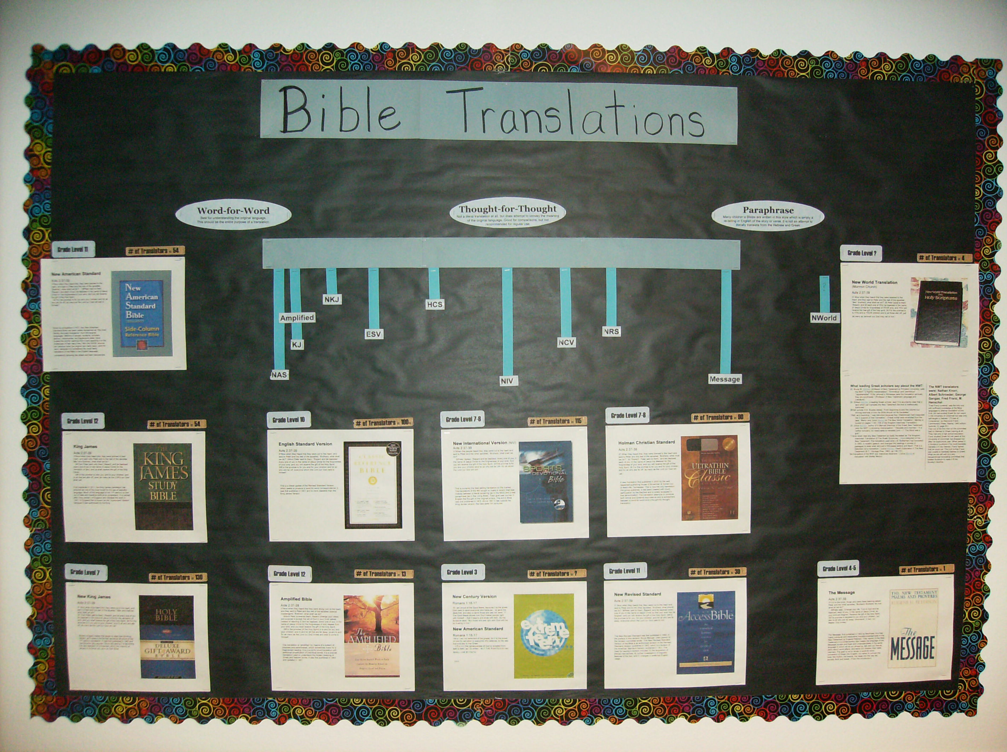
All printed pages.
High school room. Art is easily found at book seller website. Synopsis and descriptions also easily found.

Slide 23
Other ideas for teaching walls:
Map of ancient city when studying Colossians, or Ephesians.
Book Study: Verse of the day (one each class for theme)
Life of Paul or Peter or Christ. Timeline, events, writings
Child/Parent concerns
Teaching about when to pray, what to pray
Organization of congregation. Pics of elders, deacons. (4th-5th)

Slide 24
The Teacher Sets The Tone
Keep an even disposition.
Tell your expectations to the class. They must know them.
Raise your expectations!
What are God’s expectations of young people (Jr. High/H.S.)?
1 Tim. 4:12; Titus 2:6-8; Ps. 119:9-16

Slide 25
Equitable Treatment
Verbal Praise
Address Misbehavior
Speak as to adult, not down to them.
Teacher proximity
Eye Contact
Some address after class

Slide 26
Don’t let students be embarrassed to be wrong.
Teach with gentleness…
Replies to a wrong answer:
That’s not quite right.
If I understand what you have said, I disagree…
I disagree.
What does the passage say? Is that what the passage says?
Help me understand your point when the passage says…
I would partly agree with you…
You are missing the point.
That is not right.
You don’t see it yet.
The Teacher Cheat Sheet

Slide 27
Be Enthusiastic
Be at class early.
Be happy to teach.
Be enthusiastic about the topic.
Invite students to class.

Slide 28
Good Discussion
God’s place for lecture.
The Purpose of Discussion
Edification and Encouragement
Teach each other (Prov. 27:17)
Check for understanding
Let’s Discuss
James 1 – Be a doer of the word
Galatians 5:9 – a little leaven…
Ephesians 1:3 – all spiritual blessings are found ‘in Christ”

Slide 29
Good Discussion
God’s place for lectures.
The Purpose of Discussion
Dealing with a “long-winded” participant
How to bring others into the discussion (Jr. High/H.S.)
Use scenarios
Use role playing
As a student a specific question

Slide 30
Good Discussion
God’s place for lectures.
The Purpose of Discussion
Dealing with a “long-winded” participant
How to bring others into the discussion (Jr. High/H.S.)
Fielding Unexpected Questions

Slide 31
Good Questions
Ask “safe” questions
When student is silent:
My question is too difficult
My question is not understood
My question is not specific enough
Keep questions brief and clear

Slide 32
Good Questions
Examples from 1 John 4:8
“The one who does not love does not know God, for God is love”
How does John describe God?
What does John mean when he says God is love?
Explain the difference between having love and being love.
How has God demonstrated His love, or must we take John’s word for it?

Slide 33
Good Questions
You generate questions for me!
Romans 15:4
“For whatever was written in earlier times was written for our instruction, so that through perseverance and the encouragement of the Scriptures we might have hope.”

Slide 34
Good Questions
You generate questions for me!
Luke 6:40
“A pupil is not above his teacher; but everyone,
after he has been fully trained, will be like his teacher.”

Slide 35
Good Questions
You generate questions for me!
1 Peter 1:10-12
“As to this salvation, the prophets who prophesied of the grace that would come to you made careful searches and inquiries, seeking to know what person or time the Spirit of Christ within them was indicating as He predicted the sufferings of Christ and the glories to follow. It was revealed to them that they were not serving themselves, but you, in these things which now have been announced to you through those who preached the gospel to you by the Holy Spirit sent from heaven—things into which angels long to look.”

Slide 36
Good Questions
You generate questions for me!
Colossians 3:1-3
“Therefore if you have been raised up with Christ, keep seeking the things above, where Christ is, seated at the right hand of God. Set your mind on the things above, not on the things that are on earth. For you have died and your life is hidden with Christ in God.”

Slide 37
Good Questions
You generate questions for me!
Hebrews 10:1
“For the Law, since it has only a shadow of the good things to come and not the very form of things, can never, by the same sacrifices which they offer continually year by year,
make perfect those who draw near.”

Slide 38
Good Questions
You generate questions for me!
Revelation 5:4-7
“Then I began to weep greatly because no one was found worthy to open the book or to look into it; and one of the elders said to me, “Stop weeping; behold, the Lion that is from the tribe of Judah, the Root of David, has overcome so as to open the book and its seven seals. And I saw between the throne (with the four living creatures) and the elders a Lamb standing, as if slain, having seven horns and seven eyes, which are the seven Spirits of God, sent out into all the earth. And He came and took the book out of the right hand of Him who sat on the throne.”

Slide 39
Good Questions
You generate questions for me!
1 Thessalonians 1:5-7
“for our gospel did not come to you in word only, but also in power and in the Holy Spirit and with full conviction; just as you know what kind of men we proved to be among you for your sake.
You also became imitators of us and of the Lord, having received
the word in much tribulation with the joy of the Holy Spirit,
so that you became an example to all the believers
in Macedonia and in Achaia.”

Slide 40
Good Questions
Leading students to a discovery…
1 John 4:1
“Beloved, do not believe every spirit, but test the spirits to see whether they are from God, because many false prophets have gone out into the world”
Where is it helpful to lead to a discovery?
Jr. High
High School
Adults

Slide 41
Introduction/Review
Benefits of introduction.
Methods of review.
An example in a topical class.
An example in a book study.

Slide 42
Biblical Teaching Styles
Luke 6:40 “a pupil is not above his teacher; but everyone, after he has been fully trained, will be like his teacher.”

Slide 43
Biblical Teaching Styles
Parables (sometimes explained)
James 1:23-25 relate to everyday life…
James 2:1-7 (2:8, 12)

Slide 44
Biblical Teaching Styles
Illustrations (no explanation)
Matthew 5:13-16
1 Corinthians 3:6-8
2 Corinthians 5:1-3
1 Corinthians 9:24-27

Slide 45
Biblical Teaching Styles
Examples To Consider
Matthew 6:9-13
Matthew 6:1-16
Matthew 7:7-11
Mark 9:33-37
Mark 9:42-47

Slide 46
Biblical Teaching Styles
Illustrations and Application
Re-Teach (Mark 10:1-12)
Use Opportunities (Mark 10:17-27)
Silencing debate with truth (Mark 10:35-45)
Teaching with questions (Mk 10:2-3; 11:27-30; 4:13)
Consider John 4
1 Corinthians 9:20-23

Slide 47
Conclusion
Effective teaching is about using every tool to cause a student to understand – to ENSURE understanding.
Don’t preach to teach. TEACH a class.

