Slide 1
Joel & Obadiah
Notes:
Welcome to our class today, we are going to be discussing what we read in the book of Joel and Obadiah this past week. We will not be discussing Amos and Jonah even those were in our reading this past week, and there is much to study and learn there. I think these are the least studied of the books we had to choose from, so that is what led me to focus on Joel and Obadiah.

Slide 2
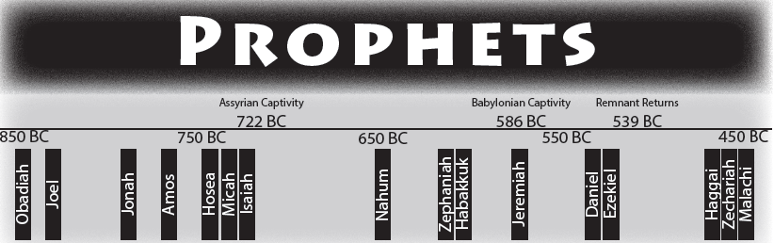
Notes:
Let’s re-orient ourselves to some of the key dates on the timeline of Biblical history during the time of the prophets.
Assyrians took the Northern Kingdom of Israel captive in 722 B.C.
Babylonians took the Southern Kingdom of Judah captive in 586 B.C. as they finished the job that year; however, it really occurred in three waves that began in 605 B.C.
605 B.C. Who was taken in the first phase of the Babylonian Captivity that wrote a major book of prophecy? Daniel
597 B.C. Second phase of captivity when Ezekiel was taken into captivity
588 B.C. Siege of Jerusalem beings
586 B.C. Babylon conquers Judah, Jerusalem is destroyed, temple destroyed
539 B.C. Babylon falls to the Persians
535 B.C. – 1st phase of the return after the 70 years of captivity in Babylon; Cyrus allows the first deportation of people to return
458 B.C. – Ezra returns in the 2nd deportation
445 B.C. – Nehemiah returns in the 3rd phase of the re-occupation of Judah
We are going to be focusing on the earliest books of those in the books of prophets where warnings were given during the time of the divided Kingdom: Obadiah and Joel

Slide 3
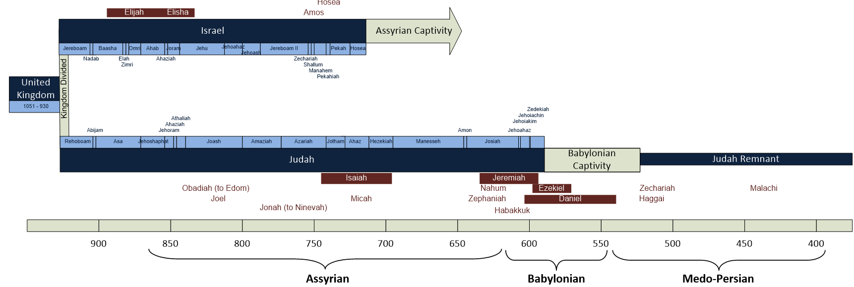
Notes:
Here’s another type of timeline showing the time from the United Kingdom all the way until many years after the remnant returns from Babylonian captivity

Slide 4
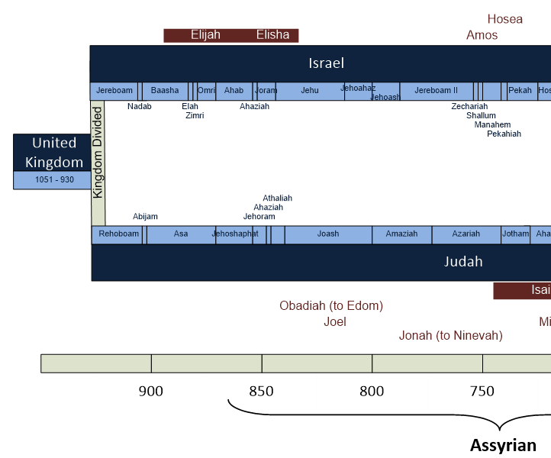

Slide 5
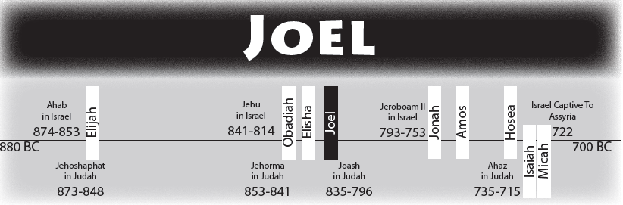
Author: Joel (1:1; Acts 2:16-21)
Joel: “Jehovah is God”
Audience: Southern Kingdom of Judah
Time of Writing: Likely ~830 B.C.
Key Themes: God’s power to judge and bless His people as He is the One True God; Repentance is expected
  (and Locusts!)
Notes:
Joel is identified as the author of the prophecies that were revealed by God and recorded here.
We have the apostle Peter quoted in Acts 2 by Luke as he recorded Peter’s sermon in Acts 2, where Peter refers to content that “was spoken by the prophet Joel” Acts 2:16-21. We don’t know anything else about Joel personally other than what is revealed in this book.
Joel’s name means “Jehovah is God”
Why might this be a fitting name for this book relative to the prophecy that was delivered?
Answer: Jehovah was about to give them some evidence that He was positioned and powerful enough to render judgement and keep the promises He had made in the covenant with His people.
His focus seems to be primarily directed at the Southern Kingdom of Judah as he mentions the elders; priests and the altar; however, there is no King mentioned. The speculation is that since there I no King mentioned the book of Joel may have fallen into a period of time during the reign of Queen Athaliah until her young grandson Joash assumed the throne. 2 Kings 11:1 – 12:2 speak of a time when Jehoiada the priest directed affairs until Joash came of age to serve as King of Judah. Another reason this timeframe makes sense is the focus on Judah’s enemies were of Tyre & Sidon; the Philistines, the Egyptians and the Edomites. There is no mention of the Assyrians or Babylonians, who were problematic for Judah in later times.
The writings of the book cover the period between ~835-830 B.C. so it was likely written around 830 B.C.
There are a few key themes in the book: a) God’s power to judge and bless His people; b) He is the one True God; and c) God expects repentance.
How does God bring about his judgement on the people in their day? Through locusts that seem to be plague worthy as they wipe out almost everything.
READ JOEL 1:1-20
Parents: Is there a lesson to be learned there in Joel 1:3? What is it?
Answer: We should be warning our children about God’s wrath to come and His great power. We should be relaying these stories to them so they know better.
How did the devasting plague of locusts represent the spiritual condition of the people of Judah?
They had allowed sin to devastate them spiritually. They were not following God any longer.
READ JOEL 2:1-11
In this section the warning of punishment doesn’t just involve locusts; but now an even greater judgement is on the horizon as Joel 2:2b says “A people come, great and strong the like of whom has never been; nor will there ever be any such after them, even for many successive generations.”
Did God warn His people that these things would happen if they chose to disobey Him one day? YES!
READ DEUTERONOMY 28:15-68; PARTICULARLY VERSES 24, 25, 33, 37, 38, 39, 40, 42
Do those curses in Deuteronomy sound familiar?
Joel 1:4, 7: Plague of locusts consuming the produce of the field and the trees
Joel 1:11-12: the destruction of the produce of the vineyards
Joel 1:10: the failure of the olive trees
Joel 1:17-20: drought brought on by lack of rain
Joel 2:1-11: the invasion of the land by a destroying army
Joel 2:17: the people of God becoming a reproach among the nations
God displays His power to punish them for their sins; and yet we will see in Joel 2:18-19 that He has the power to reward them for their repentance too.
There is something deeper that God wants from them in chapter 2, when it comes to repentance. See if you can pick up on what he wants from His people.
READ JOEL 2:12-27
Their only hope for restoration and refreshing from God is that of turning towards God in true repentance. (This also matches what we find in Deuteronomy 30:1-10)
God wants their whole heart to turn towards God, not just the outward sign or a part.
How can we fall into this trap of not giving God our whole heart in repentance?
No fornication; but still lusting in your heart
No murder; but still hating someone in your heart
Saying you forgiven someone; but then treat them rudely and with contempt
How is God described in Joel 2:13b?
Gracious, Merciful, Slow to Anger, of Great Kindness

Slide 6
What is the connection between Joel’s prophecy of the pouring out of the Holy Spirit and salvation through Jesus Christ (Joel 2:28-32)?
Notes:
READ JOEL 2:28-32
What is the connection between Joel’s prophecy of the pouring out of the Holy Spirit and salvation through Jesus Christ (Joel 2:28-32)?
Answers:
This passage speaks of a time when God will pour out His Spirit on man, signaling the arrival of a deliverance so great that is may truly be said that “whoever calls on the name of the Lord shall be saved.”
The message of salvation proclaimed by the prophet Joel would ultimately find fulfillment in the new covenant of Jesus Christ (Acts 2:21, 36-38; Rom. 10:12-13).
READ ACTS 2:14-23
Peter says that when the apostles received the baptism of the Holy Spirit, the full measure of the Holy Spirit, this prophecy was being fulfilled that would result in Revelation, Confirmation through miracles, and salvation to all who will call on the name of the Lord in obeying the Lord’s terms for remission of sins.

Slide 7
What kind of impact should God’s deliverance of Judah have had on His people (Joel 2:27)?
Notes:
What kind of impact should God’s deliverance of Judah have had on His people (Joel 2:27)?
They should have realized that God is the one true God, the “I am” was in their midst.

Slide 8
What does the “day of the Lord” depict in Joel 1:15; 2:1, 11; 2:31-32; 3:12-16?
Is the “day of the Lord” always depicting the exact same event?
How would you define the “day of the Lord”?
Notes:
READ JOEL 3:1-21
Is the “day of the Lord” always depicting the exact same event?
The precise meaning of the “day of the Lord” varies within the book and within Scripture depending on the context of the passage we find it in. It would be very misleading and confusing if we were to interpret the “day of the Lord” outside of the context where we find the phrase.
This is no different than how we might interpret other phrases when communicating with each other:
“Dad’s gonna get you” means a variety of things to a child depending on the context, it could mean “Dad’s going to tickle you”, “Dad’s going to pick you up from school”; “Dad is going to punish you for something you did wrong”, etc.
Whereas the phrase “Pappa is gonna get you” always means I’m going to tickle one of the grandkids.
What does the “day of the Lord” depict in Joel 1:15; 2:1, 11; 2:31-32; 3:12-16?
Joel 1:15: This “day of the Lord” is referring to a day (or period of time) of destruction through the plague of locusts that consume everything.
Joel 2:1: This “day of the Lord” is referring to a future punishment by an invading army. It is described in Joel 2:11 as “great and very terrible; Who can endure it?”
Joel 2:31-32: Describes this “day of the Lord” as a solemn day of deliverance when God will make salvation available to all who call on Him.
Joel 3:12-16: Describes this “day of the Lord” as God’s condemnation of the wicked and vindication of the righteous of His people. This would not be the Final Judgement Day; but judging of the wicked nations.
Why would judgement come upon the wicked nations?
Joel 3:19 “Egypt shall be a desolation, and Edom a desolate wilderness, because of violence against the people of Judah, for they have shed innocent blood in their land.”
How would you define the “day of the Lord”?
The phrase is referred to an event in which God intervenes to defeat evil, judge the wicked or to provide deliverance for the faithful.
It indicates God will be taking divine action of some sort.

Slide 9
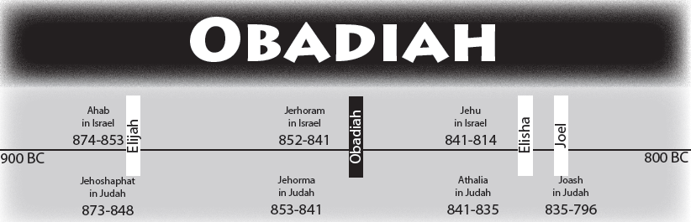
Notes:
Obadiah is likely even earlier in the timeline that Joel.

Slide 10
Author: Obadiah
Obadiah: “Servant of Jehovah”
Audience: Edom & Judah
Time of Writing: Likely ~845 B.C.
Key Themes: Judgement Against Edom; Hope for Judah
Notes:
Obadiah claims authorship of the book; however, there are a dozen men in the Bible named Obadiah; so there is no way to know which one he is.
Obadiah means “Servant of Jehovah”; which is certainly a contrast against the pride and ungodliness of Edom.
The target of the prophecy of judgement is certainly against Edom (the descendants of Esau); however, there are words of hope for Judah (the descendants of Jacob or Israel) as well in the prophecy.
There is much debate over the time of the writing:
Could have been written during the time of King Jehoram of Judah (848-841 B.C.)
Shortly after the Babylonian conquest of Judah (586 B.C.)
Or sometime between those periods.
Most would argue for the earlier date as the assault on Judah does not seem to be complete as it would have been at the time of the Babylonian conquest. The events seem to fit well with what occurred during the revolt of the Edomite Kings in 2 Kings 8:20-22 and the invasion and plundering of Jerusalem by the Philistines and Arabians that took place during the reign of Jehoram (2 Chron. 21:8-10; 16-17).
Also, Obadiah speaks of the exiles of Judah being taken to Sepharad (Obad.20) rather than to Babylon.

Slide 11
How does the message of Obadiah concerning Edom differ from his message concerning Judah (Obad. 15-16; 17-21)?
How had Edom sinned according to Obadiah 10-14?
Notes:
READ OBADIAH 1-9
What judgements were coming upon the Edomites?
Will be made small among the nations and greatly despised
All of their goods and hidden treasures will be stolen
Those whom they believe to be their allies will deceive them and prevail against them
The wise men of Edom will be destroyed
Even the mighty men will be destroyed
What may have caused Edom’s pride as a nation?
Pride of your heart has deceived you (Cleft dwellers and thoughts of superiority as though no one could bring them down)
Have much goods and food
Mighty men
Aren’t these the same things that can cause pride in the heart of men today?
Have some sense of security
Have many provisions
Have power in this world
READ OBADIAH 10-14
How had Edom sinned according to Obadiah 10-14?
Violence against your brother Jacob (Edom against Judah)
Foreigners entered the gates of Jerusalem and they were essentially supporting them by not defending them
Stood on the other side and Watched them as they suffered
Rejoiced over Judah’s demise
Entered their gates and stole their goods
Stood in the crossway to block those escaping
Returned those who had escaped
This is such an afront to their extended family doing all they can to exploit Judah in their time of need, and facilitate their enemies in capturing them.
What caused such hatred to be displayed towards Israel by Edom?
Evils of strife that go beyond those who may have actually been the source and already forgave each other.
The Feud between the Edomites (Esau’s descendants) and Israel (Jacob’s descendants) can be traced back to Jacob and Esau; however, you would have thought their families would have let it go when Esau and Jacob seemed to have made peace between each other.
[Gen 33:1-16 ESV] 1 And Jacob lifted up his eyes and looked, and behold, Esau was coming, and four hundred men with him. So he divided the children among Leah and Rachel and the two female servants. 2 And he put the servants with their children in front, then Leah with her children, and Rachel and Joseph last of all. 3 He himself went on before them, bowing himself to the ground seven times, until he came near to his brother. 4 But Esau ran to meet him and embraced him and fell on his neck and kissed him, and they wept. 5 And when Esau lifted up his eyes and saw the women and children, he said, "Who are these with you?" Jacob said, "The children whom God has graciously given your servant." 6 Then the servants drew near, they and their children, and bowed down. 7 Leah likewise and her children drew near and bowed down. And last Joseph and Rachel drew near, and they bowed down. 8 Esau said, "What do you mean by all this company that I met?" Jacob answered, "To find favor in the sight of my lord." 9 But Esau said, "I have enough, my brother; keep what you have for yourself." 10 Jacob said, "No, please, if I have found favor in your sight, then accept my present from my hand. For I have seen your face, which is like seeing the face of God, and you have accepted me. 11 Please accept my blessing that is brought to you, because God has dealt graciously with me, and because I have enough." Thus he urged him, and he took it. 12 Then Esau said, "Let us journey on our way, and I will go ahead of you." 13 But Jacob said to him, "My lord knows that the children are frail, and that the nursing flocks and herds are a care to me. If they are driven hard for one day, all the flocks will die. 14 Let my lord pass on ahead of his servant, and I will lead on slowly, at the pace of the livestock that are ahead of me and at the pace of the children, until I come to my lord in Seir." 15 So Esau said, "Let me leave with you some of the people who are with me." But he said, "What need is there? Let me find favor in the sight of my lord." 16 So Esau returned that day on his way to Seir.
How will you be remembered by man? How will you be remembered by God? What will your future generations look like?
Will they be a loving and forgiving people or ones chosen for destruction? How will you make sure your family is left without those kinds of issues?
READ OBADIAH 15-18
What would the results be of the judgement on Edom?
As they had done, it would be done to them.
Except Edom will not recover
READ OBADIAH 19-21
Judah will prevail and possess all of what Edom once had.
BONUS:
Teman: The name of a man and a city in the Old Testament
A son of Eliphaz and a grandson of Esau (Gen. 36:11). Teman was an Edomite chief (Gen. 36:15); I Chron. 1:36) who gave his name to the region where his descendants settled (Gen. 36:34)
An important city in southern Edom (Gen. 36:34, Hab. 3:3). Some scholars identify Teman with Tawilan, about eight kilometers (five miles) east of Petra.

Slide 12
Notes:
Welcome to our class today, we are going to be discussing what we read in the book of Joel and Obadiah this past week. We will not be discussing Amos and Jonah even those were in our reading this past week, and there is much to study and learn there. I think these are the least studied of the books we had to choose from, so that is what led me to focus on Joel and Obadiah.

