Slide 2
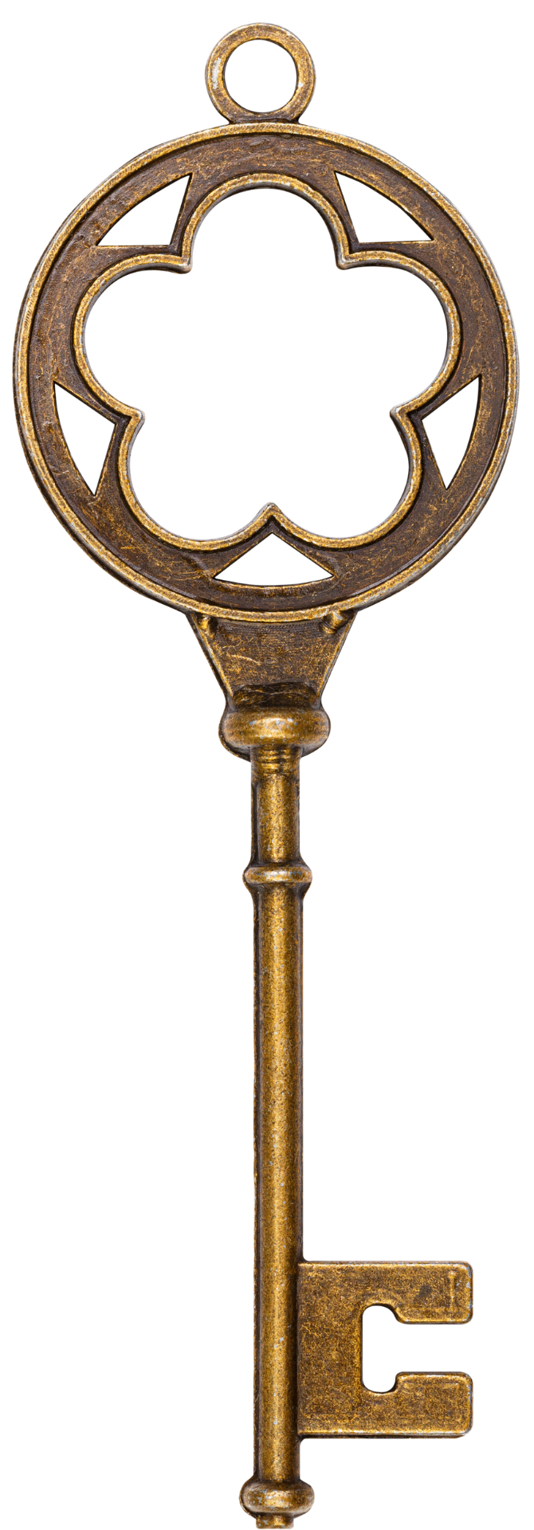
AUDIENCE
BACKGROUND
4 KEYS OF REVELATION
TIMEFRAME
STYLE
Notes:
THE KEYS
Revelation does seem like one confusing puzzle for many who study it.
However, there are some principles that will help us put that puzzle together and unlock some of the mystery of the book for us, if we will allow these principles to guide us in our study.
All of these principles can actually be found in the first chapter.

Slide 3
Allies & Enemies
Allies
Chapter 4 – God on His Throne
Chapter 5 – The Lamb and the Scroll
Enemies
Chapter 12 – The Great Red Dragon

Slide 4
The Enemies
Chapter 13 – Sea Beast
Appearance
10 horns (power)
7 heads (intelligence)
10 diadems on the horns (ruler/authority)
Blasphemous names written on the 7 heads
Appeared as a Leopard, feet like a bear, mouth like a lion
One of his heads was slain, but the wound healed

Slide 5
The Enemies
Chapter 13 – Sea Beast
Actions
Works under the dragon’s authority
Speaks arrogant words and blasphemies
Has authority for 42 months
Makes war with the saints and overcomes them
Has authority over every tribe, people, tongue, nation

Slide 6
The Enemies
Chapter 13 – Sea Beast
People’s Response to the Sea Beast
The whole earth is amazed and follows him
The world worships this beasts
Ultimately worships the dragon

Slide 7
The Enemies
Chapter 13 – Sea Beast
Who is the Sea Beast?
Rome - The Emperor

Slide 8
The Enemies
Sea Beast – The Emperor
Evidence
13:7 – Makes war with the saints
13:7 - authority over every tribe, people, tongue, nation
13:5-6 - Blasphemy, arrogant words
13:4, 8 – Is Worshiped
13:1 – Description
13:3 – The Fatal wound

Slide 9
The Enemies
Chapter 13 – Earth Beast
Description
Two horns like a lamb (13:11)
Speaks as a dragon

Slide 10
The Enemies
Chapter 13 – Earth Beast
Actions
All the authority of the first beast
Makes the earth-dwellers worship the sea beast
Performs signs
Tells earth-dwellers to make an image to the sea beast
Gives Breath to the image of the sea beast
Kills those who do not worship the sea beast
Causes everyone to receive a mark

Slide 11
The Enemies
Chapter 13 – Earth Beast
Who is the Earth Beast?
Rome – False Religion/Emperor Worship Cult

Slide 12
The Enemies
Earth Beast – Emperor Worship Cult
Evidence?
13:12 – Makes everyone worship the beast
13:15-17 – Punishes those who don’t
13:15 – gives breath to the image of the beast
13:12 – works with the sea beasts
13:13 – the wonders

Slide 13
The Enemies
The Mark of the Beast
What we are told
Everyone is supposed to have it
It is given on the right hand or the forehead
No one can buy or sell without it
This mark can be the name or # of the beast
666

Slide 14
The Enemies
The Mark of the Beast
"Do not harm the earth or the sea or the trees until we have sealed the bond-servants of our God on their foreheads.”
-Revelation 7:3
Then I looked, and behold, the Lamb was standing on Mount Zion, and with Him one hundred and forty-four thousand, having His name and the name of His Father written on their foreheads.”
-Revelation 14:1

Slide 15
The Enemies
Chapter 17
Description of the Woman
Sitting on a scarlet beast
clothed in purple and scarlet; precious stones
Gold cup in her hand of abominations and unclean things
Name on her forehead
“Babylon the Great, the mother of harlots and the abominations of the earth”
Drunk with the blood of the saints

Slide 16
The Enemies
Chapter 17
Description of the beast
Seven heads, ten horns
Earth dwellers wonder about this beast
Seven heads are seven kings
Ten horns are ten kings
Wage war against the lamb

Slide 17
The Enemies
Chapter 17
Who is the beast?
The Sea Beast (Chapter 13)
Who is the Harlot?
Rome – It’s Immorality
Evidence
Her Occupation – A Harlot
Her Cup – Filled with unclean things of her immorality

Slide 18
Allies & Enemies
Allies
Chapter 4 – God on His Throne
Chapter 5 – The Lamb and the Scroll
Enemies
Chapter 12 – The Great Red Dragon
Chapter 13 – The Sea Beast & The Earth Beast
Chapter 17 – Babylon, the Mother of Harlots

