Slide 1
Notes:
Class/study Objectives
This will not be like a typical Bible class where a book of the Bible is to be studied.
We will not make our way from beginning to end, starting with the first verse and ending with the last. We will not cover every passage or try to explain every vision.
When the class is over, you will likely find that there are still parts you do not understand.
Why use this approach?
As you have already seen, Revelation is a different book. It employs a completely different style than most other Bible books, a style with which we are unfamiliar.
Most studies of Revelation immediately drag the students into the middle of this different style and try to explain every detail of all complicated visions. That is a bad idea.
With this class I want to use a different approach. I want us to study the story of Revelation. we will step back and get the big picture of what is happening in this book. We will skip around the book pulling from different placed to put together a box top for this great puzzle.
When we are finished, I hope every student will be able to answer this question – So basically, what is Revelation all about? Once we have the story squared away, future studies into the details will begin to make more sense.

Slide 2
Class Schedule
Setting the Stage – 4 Weeks
The Story – 4-5 Weeks
Applications – 3-4 Weeks

Slide 3
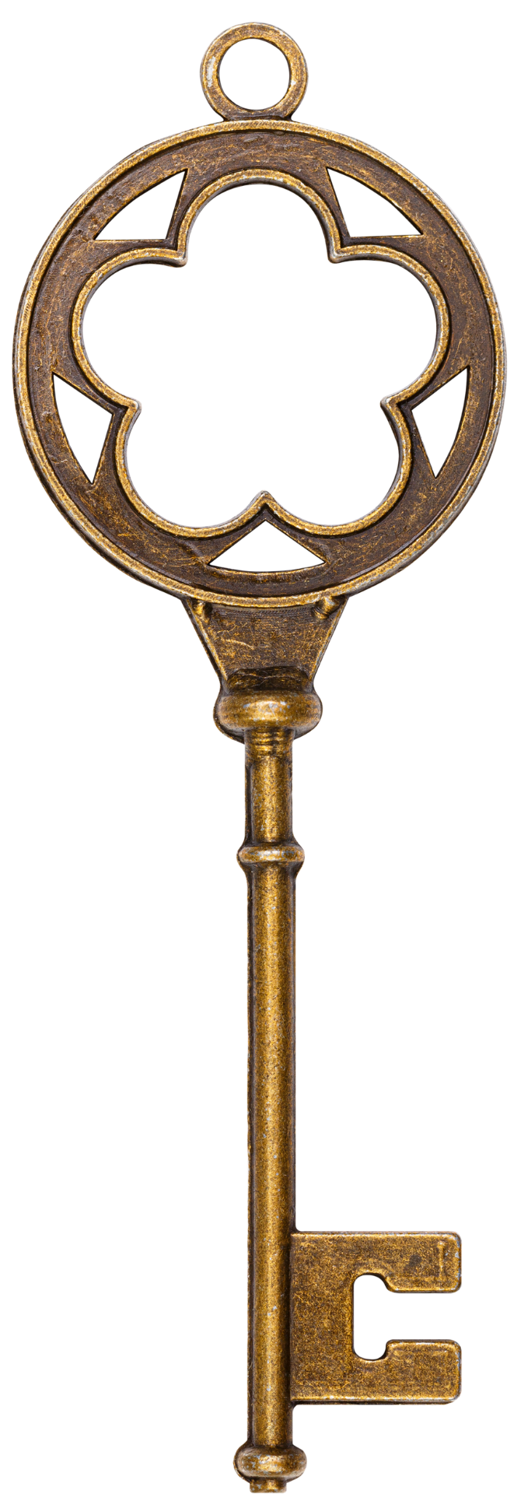
4 KEYS OF REVELATION
Notes:
THE KEYS
Revelation does seem like one confusing puzzle for many who study it.
However, there are some principles that will help us put that puzzle together and unlock some of the mystery of the book for us, if we will allow these principles to guide us in our study.
All of these principles can actually be found in the first chapter.

Slide 4
4 KEYS OF REVELATION
AUDIENCE
BACKGROUND
TIMEFRAME
STYLE
Notes:
THE KEYS
Revelation does seem like one confusing puzzle for many who study it.
However, there are some principles that will help us put that puzzle together and unlock some of the mystery of the book for us, if we will allow these principles to guide us in our study.
All of these principles can actually be found in the first chapter.

Slide 5
AUDIENCE
4 KEYS OF REVELATION
BACKGROUND
TIMEFRAME
STYLE
TIMEFRAME
Notes:
THE KEYS
Revelation does seem like one confusing puzzle for many who study it.
However, there are some principles that will help us put that puzzle together and unlock some of the mystery of the book for us, if we will allow these principles to guide us in our study.
All of these principles can actually be found in the first chapter.

Slide 6
AUDIENCE
BACKGROUND
4 KEYS OF REVELATION
TIMEFRAME
STYLE
Notes:
THE KEYS
Revelation does seem like one confusing puzzle for many who study it.
However, there are some principles that will help us put that puzzle together and unlock some of the mystery of the book for us, if we will allow these principles to guide us in our study.
All of these principles can actually be found in the first chapter.

Slide 7
AUDIENCE
BACKGROUND
4 KEYS OF REVELATION
TIMEFRAME
STYLE
Notes:
THE KEYS
Revelation does seem like one confusing puzzle for many who study it.
However, there are some principles that will help us put that puzzle together and unlock some of the mystery of the book for us, if we will allow these principles to guide us in our study.
All of these principles can actually be found in the first chapter.

Slide 8
AUDIENCE
BACKGROUND
4 KEYS OF REVELATION
TIMEFRAME
STYLE
Notes:
THE KEYS
Revelation does seem like one confusing puzzle for many who study it.
However, there are some principles that will help us put that puzzle together and unlock some of the mystery of the book for us, if we will allow these principles to guide us in our study.
All of these principles can actually be found in the first chapter.

Slide 9
AUDIENCE
1:1 – “bond-servants”
1:4 – “to the seven churches that are in Asia”
1:11 – The Churches listed
Ephesus, Smyrna, Pergamum, Thyatira, Sardis, Philadelphia, & Laodicea.

Slide 10
AUDIENCE
“John to the seven churches that are in Asia…”
-Rev. 1:4
“I, Jesus, have sent My angel to testify to you these things for the churches…”
-Rev. 22:16

Slide 11
BACKGROUND
Written - 96 A.D
Control of Roman Empire
Emperor: Domitian

Slide 12
BACKGROUND
Revelation was written during a time…
…of violent persecution against God’s people.
…when it truly cost something to be a disciple.
…when disciples had a key choice to make.

Slide 13
TIMEFRAME
"Therefore write the things which you have seen, and the things which are, and the things which will take place after these things.”
Revelation 1:19

Slide 14
TIMEFRAME
“After these things I looked, and behold, a door standing open in heaven, and the first voice which I had heard, like the sound of a trumpet speaking with me, said, "Come up here, and I will show you what must take place after these things.”
Revelation 4:1

Slide 15
TIMEFRAME
1:1 – “must take place soon”
1:3 – ”the time is near”
22:6 – “things which must shortly take place.”
22:10 – “Do not seal up the words of the prophecy of this book, for the time is near.”

Slide 16
STYLE
- Apocalyptic

Slide 17
STYLE
Working with Apocalyptic Literature
Revelation 1:12-16

Slide 21
-NUMBERS
STYLE
1 – Singularity
2 – Duality
3 – God’s Actions
3 ½ - Things in process (incomplete)
4 – Earth
6 – Human
effort/incomplete
7 – divine completion
10 – completion
12 – human completion

Slide 22
AUDIENCE
BACKGROUND
4 KEYS OF REVELATION
TIMEFRAME
STYLE
Notes:
THE KEYS
Revelation does seem like one confusing puzzle for many who study it.
However, there are some principles that will help us put that puzzle together and unlock some of the mystery of the book for us, if we will allow these principles to guide us in our study.
All of these principles can actually be found in the first chapter.

