Slide 2
Class Schedule
Setting the Stage – 4 Weeks
The Story – 4-5 Weeks
Applications – 3-4 Weeks

Slide 3
The Groups of 7
7 Seals
7 Trumpets
7 Bowls of Wrath

Slide 4
The Groups of 7
1
2
3
4
7
Interlude
5
6

Slide 5
Seal 1
6:1-2
Action
White Horse
Rider: A bow, a victor’s crown
Went out to conquer
Symbolizes…
Jesus/ The Coming of the Gospel

Slide 6
The White Horse Rider
Revelation 19:11-13
11 “And I saw heaven opened, and behold, a white horse, and He who sat on it is called Faithful and True, and in righteousness He judges and wages war.
12 His eyes are a flame of fire, and on His head are many diadems; and He has a name written on Him which no one knows except Himself.
13 He is clothed with a robe dipped in blood, and His name is called The Word of God.”

Slide 7
Seal 2
6:3-4
Action
Red Horse
Rider: A sword
Mission: take peace from the earth
Symbolizes…
Conflict following the first horse

Slide 8
The Red Horse of War
"Do not think that I came to bring peace on the earth; I did not come to bring peace, but a sword. For I came to set a man against his father, and a daughter against her mother, and a daughter-in-law against her mother-in-law; and a man's enemies will be the members of his household.”
Matthew 10:34-36

Slide 9
Seal 3
6:5-6
Action
Black Horse
Rider: A pair of scales (balances)
“A quart of wheat for a denarius”
Symbolizes…
Hardships following the conflict of 2nd horse

Slide 10
Seal 4
6:7-8
Action
Ashen Horse
Rider: “Death” followed by “Hades”
Given authority to kill…
Symbolizes…
Death from persecution

Slide 11
Seal 5
6:9-11
Action
No Horse
Souls under the alter
Martyred disciples (vs. 9)
The Question: “How long will God put up with this?”
The Answer: “They must be patient”

Slide 12
Seal 6
6:12-17
Action
God’s wrath is being brought
Judgment is coming
All stood in fear of Him on the throne
Everyone awaits its effect
”Who Shall Stand?”

Slide 13
Who Shall Stand?
Chapter 7
Vs. 1-4
Judgment and wrath are coming
But God’s people will first be marked
144,000 will be saved
Vs. 5-8
12,000 from each tribe of Israel

Slide 14
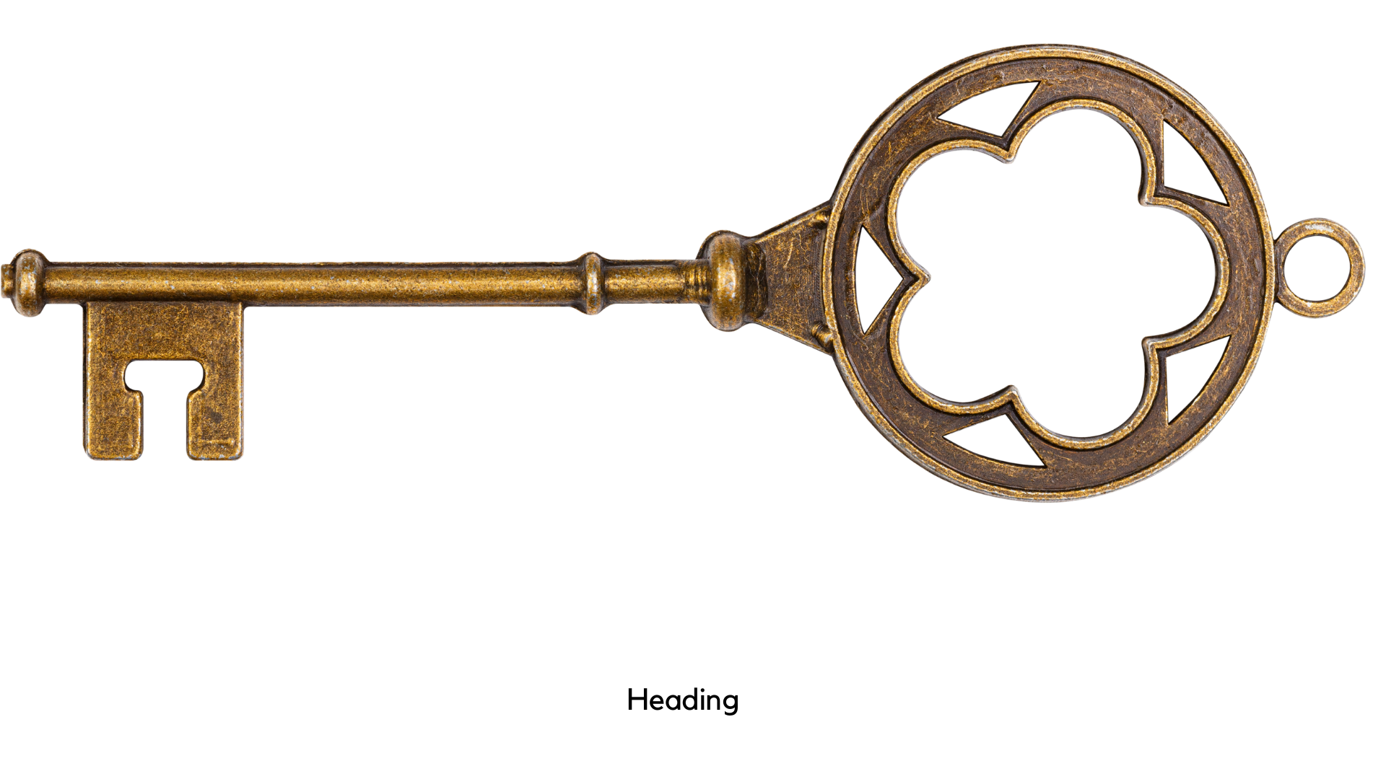
Style - Numbers
1 – Singularity
2 – Duality
3 – God’s Actions
3 ½ - Things in process (incomplete)
4 – Earth
6 – Human
effort/incomplete
7 – divine completion
10 – completion
12 – human completion

Slide 15
10
x 10
x 10
x 12
= 12,000
completion
completion
completion
Human
completion
12,000
x 12
= 144,000
Human
Completion
(tribes of Israel)

Slide 16
Who Shall Stand?
Chapter 7
Vs 9-12
God is praised for salvation
Vs. 13-17
Those who have passed are safe

