Slide 2
The Dramatic Buildup
Chapter 15
Scene 1 (vs. 1)
Scene 2 (vs. 2-4)
Scene 3 (vs. 5-8)

Slide 3
The 7 Bowls
Chapter 16
Poured on the earth – sores on earth dwellers
Poured on the sea – every living thing died
Poured on the rivers and springs – became blood
Poured on the sun – men are scorched
Poured on the throne of the beast – citizens suffered
Poured on the Euphrates – water dried up
Poured on the Air – “It is done.”

Slide 4
Har Magedon
Chapter 16
Armageddon
Har Magedon = Mount Megiddo

Slide 5
Har Magedon
Chapter 16
Megiddo in the Old Testament
Valley of Megiddo
Valley of Jezreel
Plain of Esdraelon
Deborah & Barak vs. Sisera (Judges 4-5)
Gideon and his 300 men (Judges 7)

Slide 6
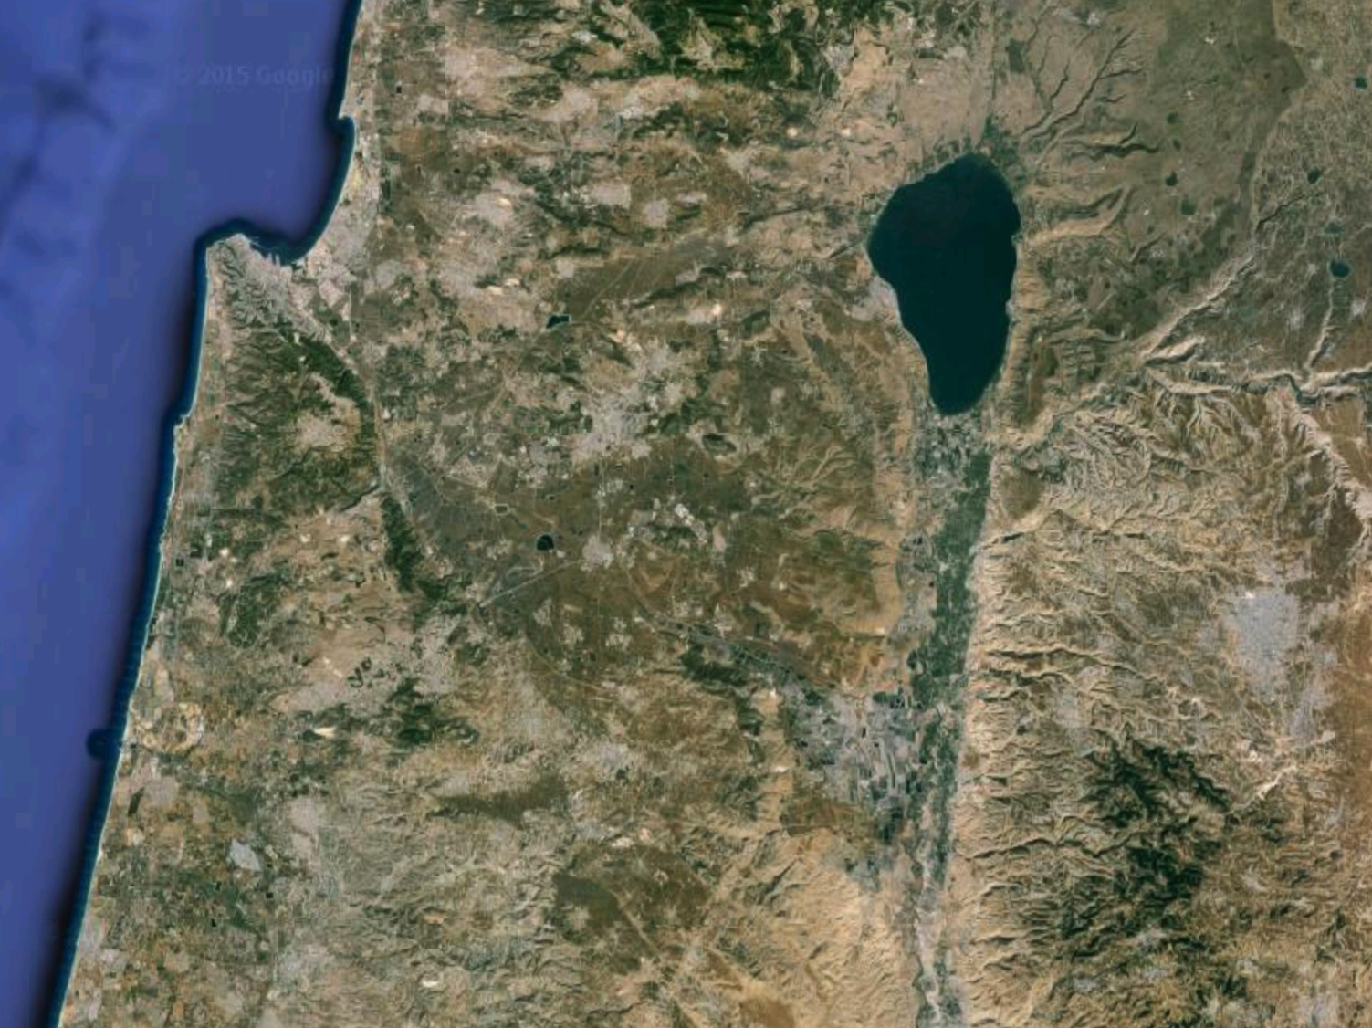
Kishon
Jordan
Jezreel

Slide 7
The 7 Bowls
Chapter 16
Poured on the earth – sores on earth dwellers
Poured on the sea – every living thing died
Poured on the rivers and springs – became blood
Poured on the sun – men are scorched
Poured on the throne of the beast – citizens suffered
Poured on the Euphrates – water dried up
Poured on the Air – “It is done.”

Slide 8
The Aftermath
Chapter 18-19
Two Themes
Mourning
Celebration

Slide 9
Mourning
Chapter 18-19
Who Mourns?
The Kings of Earth – 18:9
The Merchants of Earth – 18:11
More Merchants – 18:15
Every Shipmaster, passenger, and sailor –18:17

Slide 10
Mourning
Chapter 18-19
Why do they mourn?
They are allies of the great Harlot
She has fallen - Judgement

Slide 11
Celebration
Chapter 18-19
Who celebrates?
Heaven – 18:20
Saints – 18:20
Apostles – 18:20
Prophets – 18:20
Great multitude in Heaven - 19:1
Twenty-four elders – 19:4
Four living creatures – 19:4

Slide 12
Celebration
Chapter 18-19
Why do they celebrate?
God has finally brought Judgment
God reigns on his throne

Slide 13
Judgment
Chapter 19
Who is Judged?
Sea Beast
The False Prophet (Earth Beast)
All who fight with them

Slide 14
Review
Allies
God
The Lamb – Jesus
The Suffering Saints
Enemies
Sea Beast
Earth Beast
The Harlot
The Dragon

